Slide 1
Upgrading the sanitation trucks in new York city
By: Team Clean

Slide 2
overview
. The problem with the sanitation system
. What we plan to do
. How we plan to do it ?
. How long will it take ?
. How much will it cost ?
. Benefits of the project
. Conclusion

Slide 3
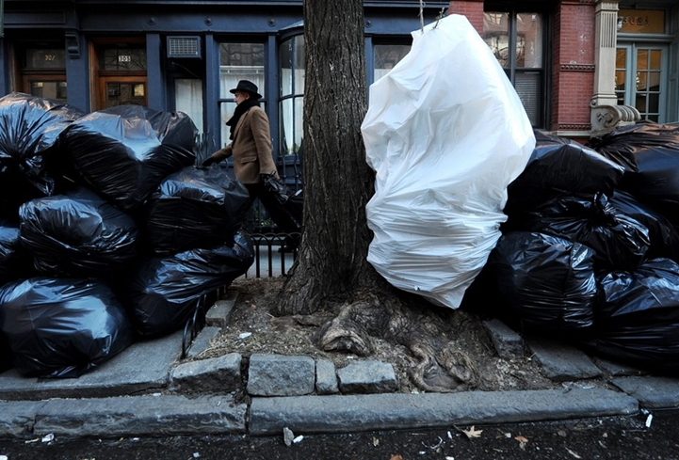
Problem
Today’s sanitation system is inefficient for being to slow, causing traffic, overflow of landfills, and overall not doing a well enough job.
Sanitation trucks cause traffic.
Leaving garbage behind on streets.
Are not making pickups frequently enough due to the extremely high population in New York City.

Slide 4
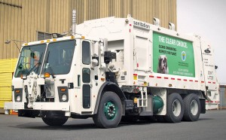
What we plan to do
Incinerator built on each truck.
Filtration system on each truck equipped to eliminate odor, smell, and toxin from the fumes.
Electric Garbage Truck
Frequent pickups during dead hours
New rules and regulations

Slide 5
How we plan to do it
Incinerator will be built comprising of:
Main Chamber
Gas Chamber
Clean out port
Igniter

Slide 6
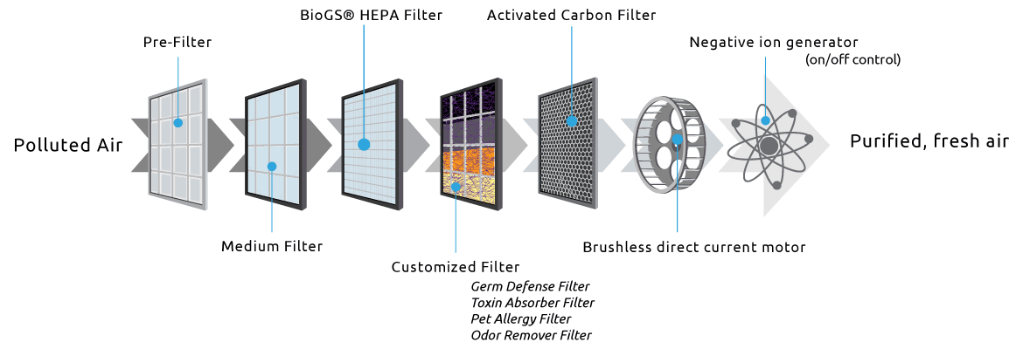
How we plan to do it

Slide 7
Schedule
The project is expected to finish by June 2019.
Progress reports by the team will be delivered each month.
Meetings each month to discuss progress and if any setbacks.

Slide 8
How much will it cost ?
Engineers on the project receive 25 US dollars per hour working a total of 40 hours per week making 1,000 a week. Expected types of engineers needed are mechanical, electrical, computer, and civil engineers.
Sanitation crew gets paid 30 US dollars per hour for a 35 hour work week making 1,050 a week.
Cost for a total of 2320 modified sanitation trucks will cost about 470 million US dollars.

Slide 9
Benefits
Clearing landfills that can then be used for future projects example housing or commercial.
Faster pickup time and reduction in road congestion.
More convenient way of getting rid of trash with a time saving method.
Without landfills there is no need for long term workers and machinery saving money for the corporation and using that money elsewhere.

Slide 10
Conclusion
Our team of engineers have carefully designed this project to benefit the city and make communities better.
A project on such a large scale like this will impact many and become very beneficial thus making it a time consuming and expensive project that is worthwhile.
If the project is authorized it will change New York City forever.

Slide 11
References
Buhrkal K., Larsen, A., Ropke S. (2012, May 22). The Waste Collection Vehicle Routing Problem with Time Windows in a City Logistics Context. Procedia – Social and Behavioral Sciences, 39, 241-254. https://doi.org/10.1016/j.sbspro.2012.03.105
Rivoli, D. (2016, June 16). NYC private garbage trucks 'unsafe' with maintenance issues. Retrieved April 11, 2018, from http://www.nydailynews.com/new-york/nyc-private-garbage-trucks-unsafe maintenance-issues-article-1.2676855
Kelly-Detwiler, P. (2015, March 04). Electric Garbage Trucks: Huge Energy Savings And They Won't Wake You Up In The Morning. Retrieved April 11, 2018, from https://www.forbes.com/sites/peterdetwiler/2015/03/04/electric-garbage-trucks-huge-energy- savings-and-they-wont-wake-you-up-in-the-morning/#69aceaa36368
Madsen, A. M., Alwan, T., Ørberg, A., Uhrbrand, K., & Jørgensen, M. B. (2016, July). Waste Workers’ Exposure to Airborne Fungal and Bacterial Species in the Truck Cab and During Waste Collection. Annals of Occupational Hygiene, 60(6), 651-668. https://doi.org/10.1093/annhyg/mew021

