Slide 1
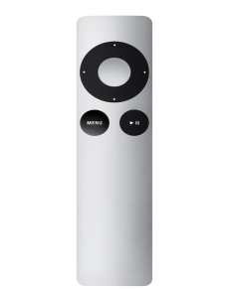
Apple TV Remote Control: 2nd and 3rd Generation
By: Evert Magana

Slide 2
Introduction and History
Apple was created by Steve Jobs and Steve Wozniak in 1979
Started off with a computer and went on to make iPhones
First Apple TV remote was sold in 2006 for $299
2nd generation was sold in 2010 (more applications)
Major difference was the remote control
Newest generation includes Siri and touch pad (4th generation)

Slide 3
Description
Cased in a grey aluminum cover
Dimensions: 12cm x 3cm x 0.2cm
Buttons include: directional buttons, select button, menu button and pause/play button
Used for streaming music, movies, TV shows, and media from other streaming applications
Uses a CR2032 battery

Slide 4
Outer Components
Directional Buttons
Up, down, left and right
Can be used to control volume, fast forward or rewind, change songs, change channels
Select Button
Can be used to Pause and Play
Select options
If held down for 3 seconds, pulls up accessibility settings (voice captioning, voice-over, zoom and speaker settings)

Slide 5
Outer Components (continued)
Menu Button
Used to go to previous page
When held down, takes you to Apple TV home
When clicked twice at Apple TV home page, starts screensaver mode
Pause/Play Button
a) Pause and play all media

Slide 6
Inner Components
Battery
Uses a CR2032 battery or a BR2032 lithium 3V coin battery
Wireless connection
Uses an infrared transmitter (LED light bulb)
sends out pulses of infrared light that has its unique binary code that corresponds with its command
On the Apple TV, there is an infrared receiver that decodes all the binary codes sent to it.
Inside there is a fiberglass circuit board that contains the electronics and the battery connections
there are contact points where the buttons on the remote are placed (morse-code)

Slide 7
Thank you

Slide 8
Getting Started
Pairing Apple TV Remote
Make sure your Apple TV component is all connected and working
Be close enough to the Apple TV and there is a clear line of site from the remote to the Apple TV.
Press and hold down the menu button and right button for six seconds.
A chain link symbol will pop up on your screen to insure your connection.

Slide 9
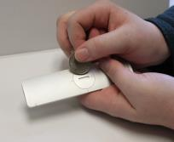
Helpful Tips
Replacing the Battery
Locate the battery component on the back of your remote
Use a coin to turn the battery cover clockwise until the cover is opened
Use finger nail or hold remote upside down to remove old battery
Insert new batter in compartment
Place cover back on and tighten with coin

Slide 10
More Helpful Tips
Unpair remote
One way to unpair the remote is to hold down the MENU button and the right button for six seconds.
Another way is to access the settings menu, click general settings, then click unpair Apple TV remote.

