Slide 1
MTA App
Kevin Alvarez, Fayrouz Mikhael, Bujar Sefa, Maya Dara Sofia Pasiliao

Slide 2
Agenda
1. Introduction
1.1 Problem Statement
1.2 Background
1.3 Needs Statement
1.4 Objective
2. Proposed Technical Approach
2.1 Requirements
Costs
2.2 Architecture Design
2.3 Implementation Design
2.3 Quality Assurance Plan
3. Expected Project Results
3.1 Measure of Success
4. Schedule
References

Slide 3
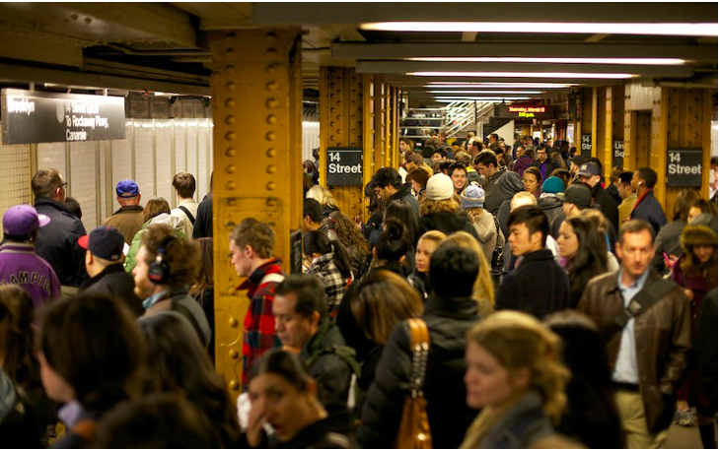
Introduction
Problem Statement.
Background.
Needs Statement.
Objective.
MTA Commuters. (Pham, 2017)

Slide 4
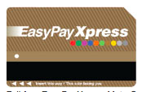
1.1 Problem Statement
No streamlined application.
Not MTA affiliated.
Full-fare EasyPayXpress MetroCard (Metropolitan Transportation Authority, n.d.a.).
65 MTA Mobile Applications (Metropolitan Transportation Authority, n.d.b.).

Slide 5
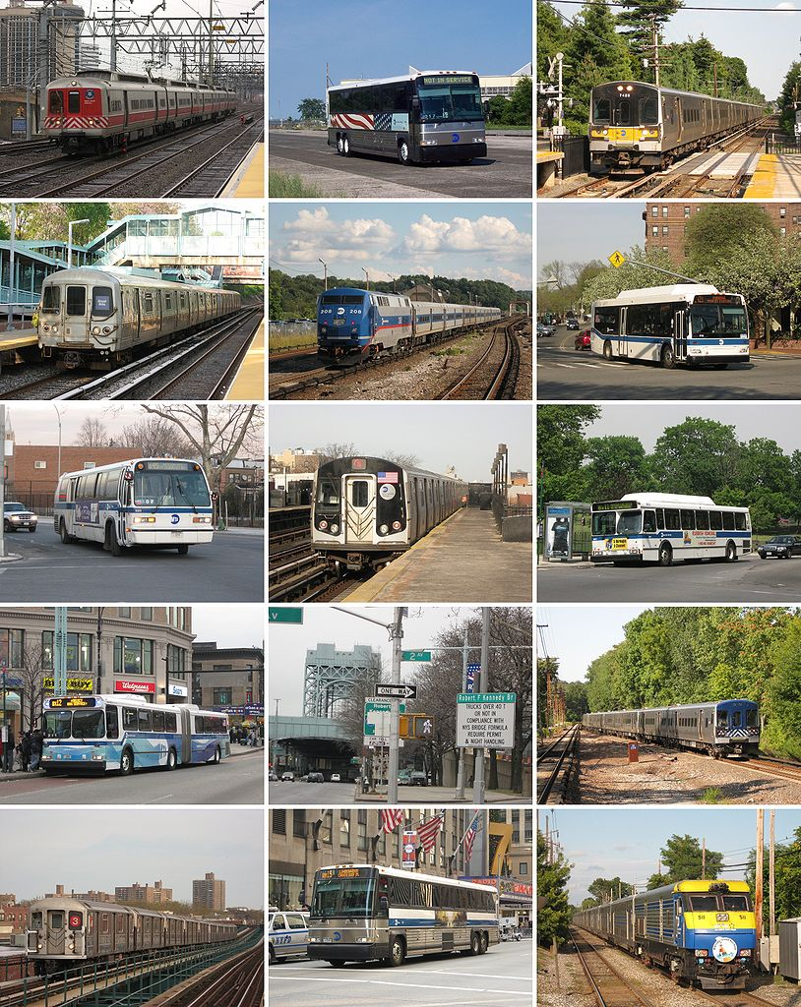
1.2 Background
2 Billion Riders - 2016
CCNY Students - Daily.
Modes of Transportation.
Modes of transportation (Metropolitan Transportation Authority, n.d.c.).

Slide 6
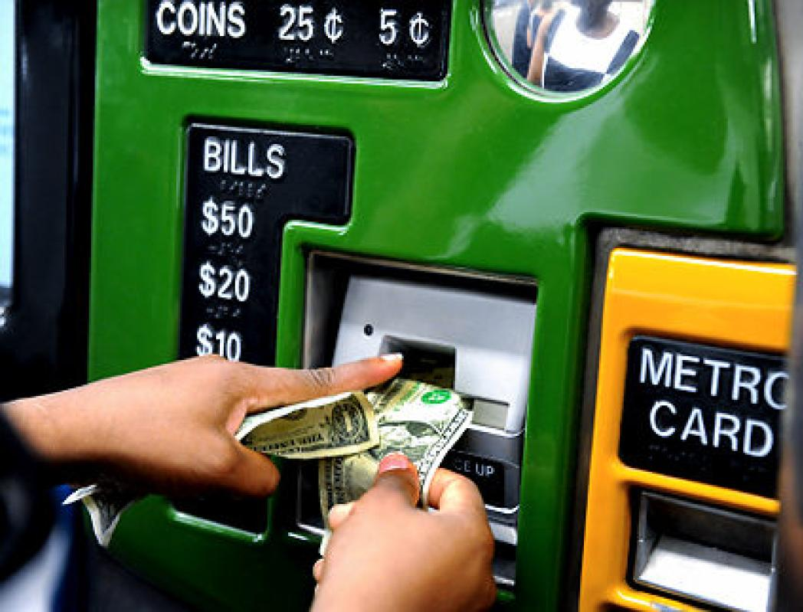
1.3 Needs Statement
Long lines.
Multiple modes of transit with different applications.
Significant amount of time is spent refilling MetroCards that some will lose, or swiping an empty MetroCard at a turnstile.
MTA money machine. (DeJohn, 2011)
A subway turnstile readout reads "insufficient fare." (CBS2, 2014)

Slide 7
1.4 Objective
Make New York City commute more pleasant by providing . . .
One streamlined application, operated directly by the MTA.
Transit arrivals and delays information.
Daily Schedule.
Ability to refill MetroCards via application.

Slide 8
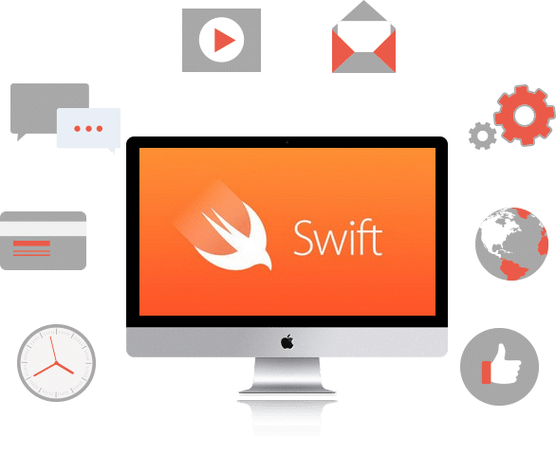
2. Proposed Technical Approach
Requirements.
Architecture Design.
Implementation Design.
Quality Assurance Plan.
Javascript Logo.
(“Javascript Logo,” n.d.)
HTML5 Logo.
(“HTML5 Logo,” n.d.)
Java Development Logo.
(“Java Development Logo,” n.d.)
CSS Logo.
(“CSS Logo,” n.d.)
Swift App Development.
(“Swift App Development:, n.d.)

Slide 9
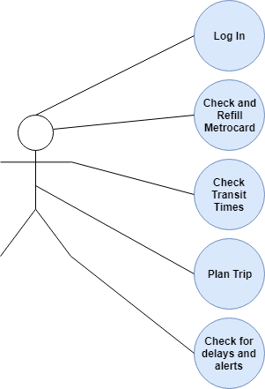
2.1 Requirements
Case system diagram

Slide 10
Costs
Requirements | Cost
Front-End Developer | $42,000 - $106,000 per year
Back-End Developer | $72,000 per year
Quality-Tester | $72,000 per year
Full-Stack Developer | $72,000 per year
Office Spaces | $70,000 per year
Servers | $150,000 per year
The application | $140,000 to $210,000 per year
The Maintenance Costs | $20,000 per year

Slide 11
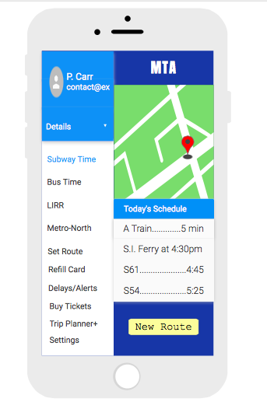
2.2 Architecture Design
Options: ⇒

Slide 12
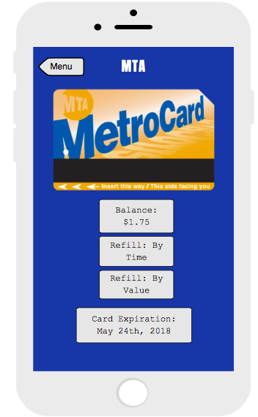
2.2 Architecture Design
Money Options: ⇒
Refill ⇒

Slide 13
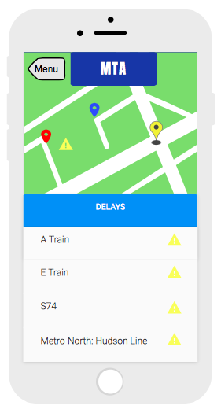
2.2 Architecture Design
Normal Delays:

Slide 14
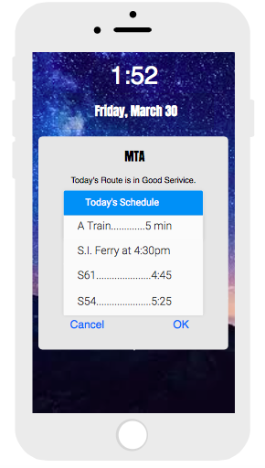
2.2 Architecture Design
Daily Notification Route: ⇒

Slide 15
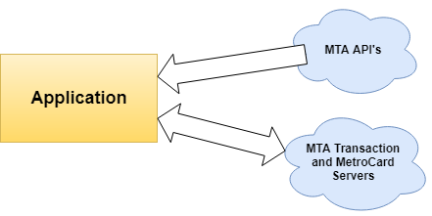
2.3 Implementation Design
Where the proposed application gathers its data from and where transactions will take place.

Slide 16
2.4 Quality Assurance Plan
Outline goals
Streamlined, acceptable load time, easy to use.
Can handle stress load of NY commuters.
Personnel
Ensuring proper qualifications and training
Funding
Preventing developmental delays
Bugs
Quality assurance engineers
Beta testing program
Slowed rollout
Notes:
Outline goals
Streamlined, acceptable load time, easy to use.
Can handle stress load of NY commuters.
Personnel
Ensuring proper qualifications and training
Minimum BS in computer/software engineering field with prior experience working with trip software/app development.
Funding
Preventing developmental delays
Creating a project schedule and deadlines
Require periodic audits of schedule adherence to ensure efficiency and prevent wasting time/money.
Bugs
Quality assurance engineers
QA Engineers will be in charge of creating tests the app must pass. For instance, testing different types of inputs and such.
Will report any bugs to developers that are found.
Beta testing program
Letting beta testers find ways to exploit system (Time Out New York Contributors, 2017).
UI and UX reporting and suggestions to pinpoint aspects of software users have trouble understanding.
Slowed rollout
After completing initial beta tests, start rolling out an updated app to top users of old apps and slowly switch everyone over.

Slide 17
3. Expected Project Results
More user satisfaction.
Fewer in-app maintenance costs.
EasyPay component incorporation.
Fewer lines and MTA money machines at stations.
Fewer resources spent training workers on how to provide support for different applications.
Easier access to purchasing and refilling MetroCards.
MetroCard revenue to increase.
Increase in retention rates of app users.

Slide 18
3.1 Measure of Success
Star ratings (the number of times that a user opens up the app).
The number of application downloads (User Growth Rate).
The number of uninstallation of the application.
Session Length (The amount of time that users spend on the app per session).
Social Shares (The number of times the app is recommended or shared on social media).
Reviews (The total number of reviews since that shows a user is passionate and engaged enough to take the time to write a review of your app whether it is good or bad).

Slide 19
4. Schedule
April 1st, 2018
April 4th, 2018
April 8th - August 26th , 2018
August 28th - October 2nd, 2018
October 15th, 2018
December 28th, 2018
App Development
Publish
Next Steps
Board Discussion
Developer Discussion
Test Application
Discuss app basics, discuss the initial scope of the project, and document the system requirements.
Contact the develop and plan the framework of the application.
Begin work on the MTA app application.
Test the application for bugs.
Implement application for the public.
Figure out if changes need to be made.

Slide 20
References
[CSS Logo]. (n.d.). [Digital Image] Retrieved April 16, 2018, from https://appendto.com/2016/11/what-is-css-grouping-and-what-is-it-used-for/
[HTML5 Logo]. (n.d.). [Digital Image] Retrieved April 16, 2018, from
https://upload.wikimedia.org/wikipedia/commons/6/61/HTML5_logo_and_wordmark.svg
[Java Development Logo]. [Digital Image] (n.d.). Retrieved April 16, 2018, from http://www.signintec.com/javadevelopment.html
[Javascript Logo]. (n.d.). [Digital Image] Retrieved April 16, 2018, from https://postparaprogramadores.com/crud-javascript/
[Swift App Development]. (n.d.). [Digital Image] Retrieved April 16, 2018, from http://www.agileinfoways.com/swift-app-development/
CBS2. (2014, December 2). A subway turnstile readout reads "insufficient fare." [Digital Image]. Retrieved April 16, 2018, from http://newyork.cbslocal.com/2014/12/02/commuter-woes-continue-for-thousands-of-lirr-metro-north-riders-after-computer-glitch/
Clark, Kelsey. (2014, November 12). Commuter students face hidden drawbacks and costs. Deseret News. Retrieved from https://www.deseretnews.com/article/865615275/Commuter-students-face-hidden-drawbacks-and-costs.html
DeJohn, I. (2011, October 04). MTA Money Machine. [Digital Image]. Retrieved April 16, 2018, from
http://www.nydailynews.com/new-york/metrocard-glitch-takes-extra-fare-passenger-cards-pay-bus-ride-article-1.960619
Engard, B. (2017, April 28). The Sides of Software Development: From Front End vs Back
End to Full Stack. Retrieved April 10, 2018, from https://www.thesoftwareguild.com/blog/front-end-vs-back-end/
Glassdoor Inc. (n.d.). Metropolitan Transportation Authority Applications Developer Salaries.
Retrieved April 01, 2018, from https://www.glassdoor.com/Salary/Metropolitan-Transportation-Authority-Applications-Developer-Salaries-E366592_D_KO38,60.htm

Slide 21
References
Metropolitan Transportation Authority. (n.d.a.). EasyPay MetroCard: Convenience & Savings
Apply. Retrieved April 13, 2018, from http://web.mta.info/metrocard/EasyPayXpress.htm
Metropolitan Transportation Authority. (n.d.b). App Gallery. [Digital Image]. Retrieved April 9, 2018, from
http://web.MTA.info/apps/
Metropolitan Transportation Authority. (n.d.c.). Metropolitan Transportation Authority Modes of transportation. [Digital image].
Retrieved April 15, 2018, from https://en.wikipedia.org/wiki/Metropolitan_Transportation_Authority#/media/File:Sample_of_MTA_services_MNRR_NYCT_Bus_LIRR_MTA_Bus_LI_Bus_NYCT_Subway.jpg
Metropolitan Transportation Authority. (n.d.d.). On the Go for your PDA. Retrieved April 02,
2018, from http://web.mta.info/nyct/service/OnTheGo.htm
Metropolitan Transportation Authority. (2011). Metropolitan Transportation Authority Mission
Statement, Measurements and Performance Indicator Report Covering Fiscal Year 2011. Retrieved April 1, 2018, from http://web.mta.info/mta/compliance/pdf/2011_annual/MissionStatementMeasurement.pdf
Metropolitan Transportation Authority. (2017a). MTA 2017 Adopted Budget February Financial
Plan 2017 – 2020. Retrieved April 2, 2018, from http://web.mta.info/mta/budget/pdf/MTA 2017 Adopted Budget February Financial Plan 2017-2020.pdf
Metropolitan Transportation Authority. (2017b). MTA Capital Program 2015-2019 Renew.
Enhance. Expand. Retrieved April 1, 2018, from http://web.mta.info/capital/pdf/WEB2015-2019Program_reduced.pdf

Slide 22
References
Moore, T. (n.d.). What's the Cost to Maintain an App? - App Press. Retrieved April 08, 2018,
from https://www.app-press.com/blog/whats-the-cost-to-maintain-an-app
Pham, D. (2017, January 24). MTA Commuters. [Digital Image] Retrieved April 16, 2018, from https://www.6sqft.com/mta-admits-subway-
service-is-terrible/
Recruiter.com, Inc. (n.d.). Software Quality Assurance Engineer/Tester Salary: Latest Wage and
Compensation Trends in Your Area. Retrieved April 02, 2018, from https://www.recruiter.com/salaries/software-quality-assurance-engineers-and-testers-salary
Time Out New York Contributors. (2017, June 05). This MetroCard hack gives you a free
subway ride. Retrieved April 08, 2018, from https://www.timeout.com/newyork/news/this-metrocard-hack-gives-you-a-free-subway-ride-060517
Transit App, Inc. (2016). Transit • bus & subway times. [Mobile application software]. Retrieved from
https://itunes.apple.com/app/apple-store/id498151501?mt=8
Yarmosh, K. (2015). How much does the application cost . Retrieved February 4, 2015 from
https://savvyapps.com/blog/how-much-does-app-cost-massive-review-pricing-budget-considerations

