Slide 1
Seeking employment and teammates Part 3
Markel Chater 15
Engl 21007

Slide 2
Cover Letter
What is the purpose of the cover letter?
How is content affected?
Who is the audience?

Slide 3
Cover letter
First writing sample your potential employer will see
Creates a picture of you as a potential employee
Should inspire potential employers to learn more about you
An argument for why you should be granted an interview

Slide 4
Cover Letter
Written in paragraphs
Salutation (audience analysis, research) who is this addressed to?
Opening paragraph- why you are writing, (audience analysis, about the company)
Body paragraphs- discuss strengths and how you have applied them
Closing- thanks for time, gesture towards interview or further communication

Slide 5
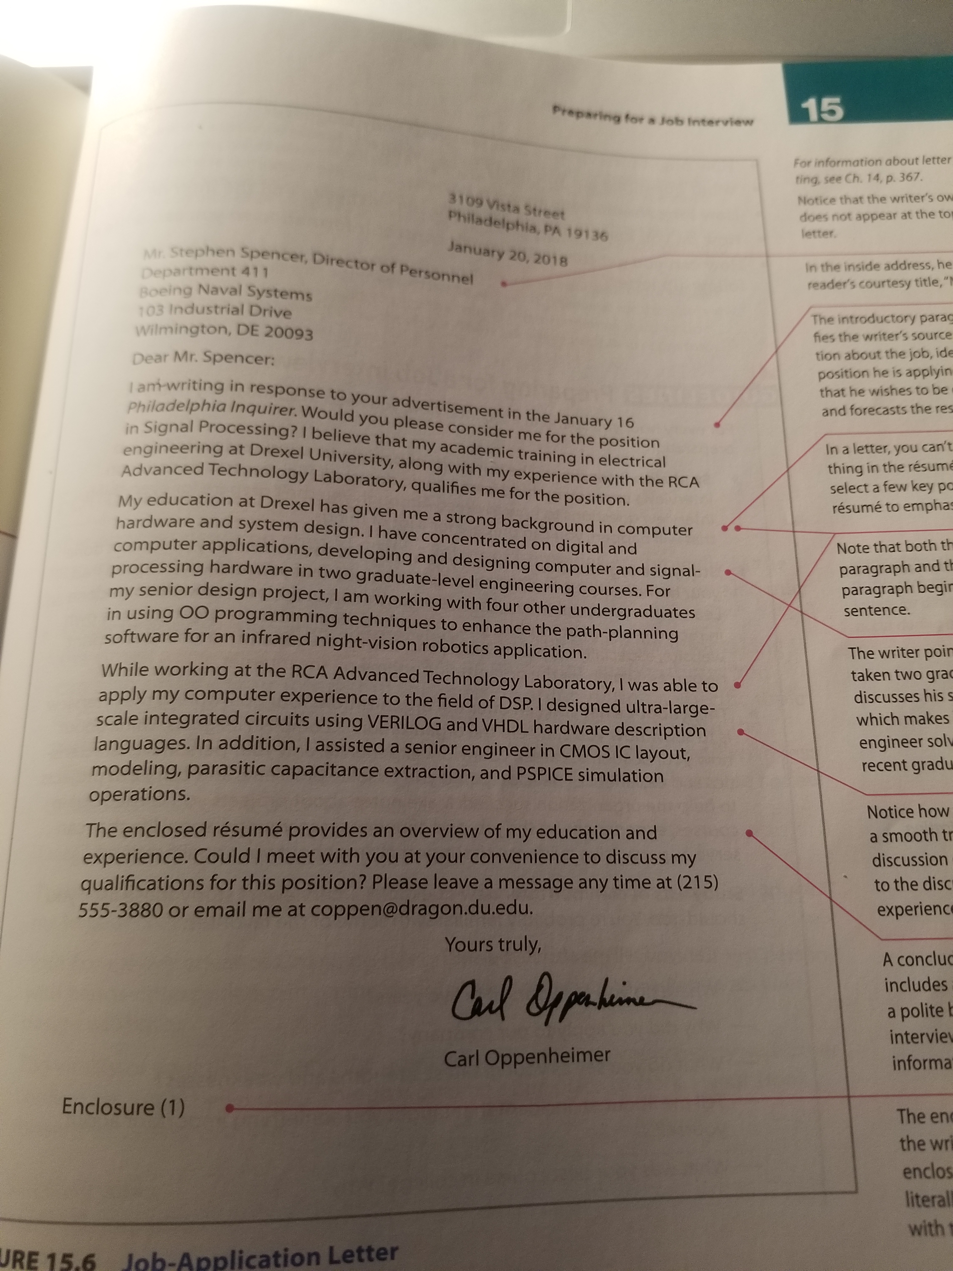
Cover Letter
(Markel 415)

Slide 6
How do engineers find work? Workers?

Slide 7
Job Posting
How does audience impact content and purpose?
How can engineers use job postings to their advantage in pursuing employment?

Slide 8
Job Posting
Engineer job title
Project engineer
Chief Engineer
Assistant Engineer
Engineering Supervisor
Advanced Engineer

Slide 9
Job Posting
Job Summary
Summary of position and role in the company
Overview of company and expectations for the position
Outline required activities and responsibilities related to the position

Slide 10
Job Posting
Engineer responsibilities and duties
Outline the functions this position will form on a regular basis
Discuss how this job functions within the entire organization
Mention who this position reports to

Slide 11
Job Posting
Qualifications and Skills
Outline education, previous job experience, certifications, and skills
Possibly personality traits
Keep this brief and concise

Slide 12
Job Posting Samples
https://www.indeed.com/hire/job-description/engineer
https://resources.workable.com/software-engineer-job-description
https://hiring.monster.com/hr/hr-best-practices/recruiting-hiring-advice/job-descriptions/electrical-engineer-job-description.aspx
https://targetjobs.co.uk/careers-advice/job-descriptions/276099-mechanical-engineer-job-description

Slide 13
Job Posting Samples
http://engcen.com/job/civil-engineer-north-charleston-south-carolina-47133
https://www.google.com/search?source=hp&ei=wALgW8DuMI6k_Qa26KrwDg&q=engineer+job+posting+&oq=engineer+job+posting+&gs_l=psy-ab.3..35i39j0j0i22i30l8.671.5737..6308...0.0..0.285.1827.5j4j3......0....1..gws-wiz.....0..0i67j0i8i13i30.vCn7IySMgkM&ibp=htl;jobs#htidocid=wz6huKZextaCn-QpAAAAAA%3D%3D

