Slide 1
The Logistics of Proposals
Markel Chapter 16

Slide 2
Students will be able to…
Comprehend, identify, and replicate all conventions of the genre of the technical proposal
Will work in their assigned groups on developing aspects from the previous night’s online homework into something presentable for the class and as well content for their proposal
Present material to their classmates for comment and critique

Slide 3
How is the content of the proposal largely affected by audience and purpose?
Must consider audience knowledge and stance about what you are proposing
What are your audience’s needs? What do they already know?
What are you trying to accomplish with this proposal?

Slide 4
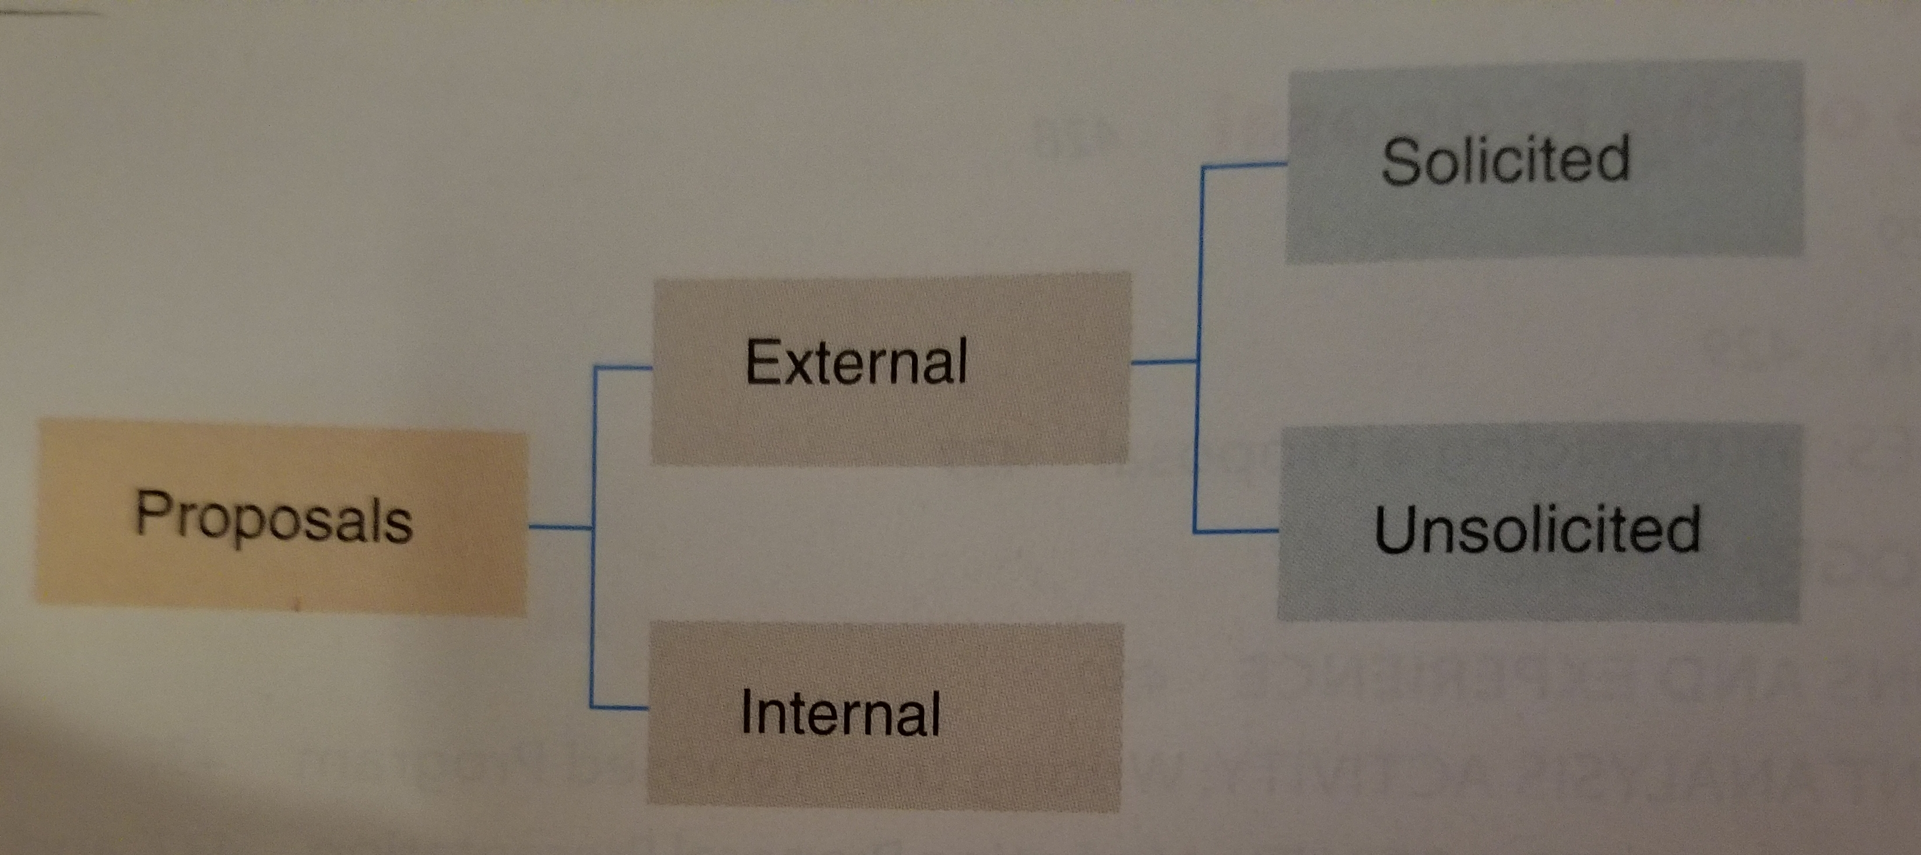
Proposals
An offer to carry out research or to provide a product or service.
An argument.

Slide 5
Internal Proposals
an argument, submitted within an organization, for carrying out an activity that will benefit that organization.
Might recommend that an organization conduct research, purchase a product, or change an aspect of policies/procedures

Slide 6
External Proposals
A document that solicits outside business, submitted to outside organizations.
Solicited- submitted In response from a prospective customer. Submitted when a customer (company) wants to purchase specific goods/services
Information for a bid (IFB)- used for standard products (computers, cars, equipment)
Bid for a specific brand/model= request for quotation (RFQ)
Request for a proposal (RFP)- used for a more customized, specific goods/services

Slide 7
Unsolicited Proposals
Similar to a solicited proposal except it does not refer to an RFP, was not formally requested, but the supplier was invited to submit a proposal based on previous discussions.

Slide 8
Deliverables
What the supplier will provide at the end of the project
Research- investigate data and then provide a report about what came out of the research
Goods and services- An offer to supply a tangible product, services, or a combination of the two.

Slide 9
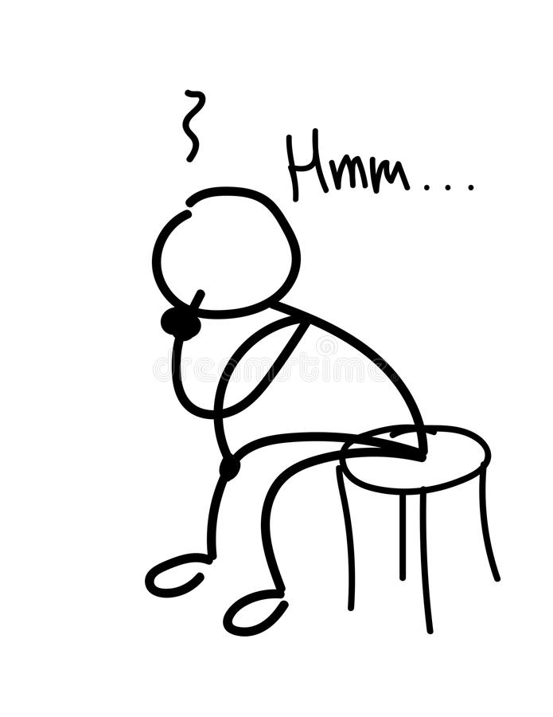
Why do Engineers do research?

Slide 10
Deliverables- Research
After the proposal has been approved, progress reports are standard.

Slide 11
Deliverables- Research
The end product provides a recommendation report
Tells the whole story of the research project, beginning with problem that motivated the research, continuing with the methods used in execution, results, and conclusions and recommendations.

Slide 12
What do proposals do?
Purpose?
Argue and Persuade
Convince readers that the future benefits will outweigh the immediate and projected costs.
Convince the reader that you:
Understand their needs
Pre-determined what you plan to do and that you are able to do it
You are a professional and committed to fulfilling your promises.

Slide 13
Understanding the Reader’s Needs
The most crucial yet most undeveloped and least paid attention to piece of the proposal is the definition of the problem or how the proposed project responds to it.

Slide 14
Reader’s Needs
For external, unsolicited proposals, keep in mind the following
Understand that what makes an argument persuasive varies between cultures
Budget enough time for translation
Use simple graphics with captions
Write short sentences with common vocabulary
Use local conventions of punctuation, spelling, grammar, etc
Ask if the customer will review your work
*(Markel 428-429)

Slide 15
Describing what you plan to do
Once you have drawn attention to the task, describe your plan of action.
Convince readers
Discuss procedures and equipment
Justify choices
Present a complete picture from start to finish
Detailed plan showing you have already started working.

Slide 16
Professionalism
Show the kind of person/team you are/have
Credentials/work history
Work schedule (task schedule)
Quality Control Measures
Budget
(Markel 430) discusses honest proposals and standing by your work

Slide 17
Content- Writing the Proposal
Personnel- managers, support people, technical personnel
Facilities- do you have the necessary facilities? Can you lease them?
Do you have the necessary equipment? Can you buy it, lease it, or subcontract the work?

Slide 18
Boilerplate
Proposals almost always recycle information
Boilerplate texts- written text that can be reused in new contexts or applications without being changed much from the original.
Descriptions of other projects, histories and descriptions of the company, and resumes of the of the primary personnel who will work on the project.

Slide 19
Proposal- Structure
Introduction
Problem
Objectives
Solution
Methods
Resources
Management
Guidelines (if writing an external, IFB, etc.)

Slide 20
Proposal Structure- summary
Covers the major elements of the proposal.
Covers the major elements of the proposal in 1-2 sentences.
Define problem
Describe proposed program and provide a brief statement of your qualifications and experience.
Completion date and budget.

Slide 21
Proposal Structure- Introduction
Needed to help readers understand the context, scope and organization of the proposal (Markel 432).
Should answer the following questions
What is the opportunity or problem
What is the purpose of the proposal
What is the background of the opportunity or problem
What are your sources of information
What is the scope of the proposal
What is the organization of the proposal
What are they key terms that you will use in the proposal

Slide 22
Proposal Structure- Proposed Program (Plan of Work)
Explanation of what you want to do with project
Need to show you have done your homework
Research! APA citations. (Markel 433) top of page

Slide 23
Proposal Structure- Qualifications and Experience
A Few paragraphs on yours and your team’s credentials.

Slide 24
Budget
Provides specifics on how much the project will cost.
Direct Costs- salaries, fringe benefits of program personnel, travel costs, costs of necessary equipment, materials and supplies.
Indirect Costs (overhead): usually expressed as a percentage, clerical expenses not devoted to any one project, operating expenses, maintenence

Slide 25
Proposal Structure- Appendixes
Task schedule- table, bar chart, network diagram (Markel 436-437)
Boilerplate statements
Evaluation Technique – any procedure used to determine whether the proposed program is both effective and efficient.
Quantitative evaluations- tests of measurable qualities, such as project increases
Qualitative evaluations- tests improvement, for example, increased workmanship.
(Markel 438)

