Slide 1
FreeGarden EARTH Compost Bin
Courtni Holness

Slide 2
Title and Content Layout with List
Add your first bullet point here
Add your second bullet point here
Add your third bullet point here

Slide 3
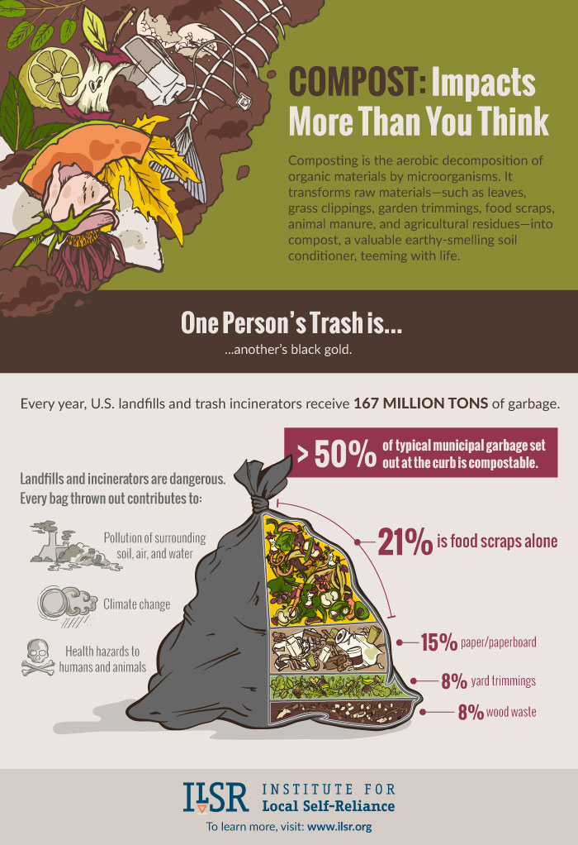
Purpose of Composting
Reduce greenhouse gas emissions.
Convenience
A method of recycling

Slide 4
Lead the market
Passion for environmental protection
Offers a range of products and services
(Enviro World Corporation, 2009)

Slide 5
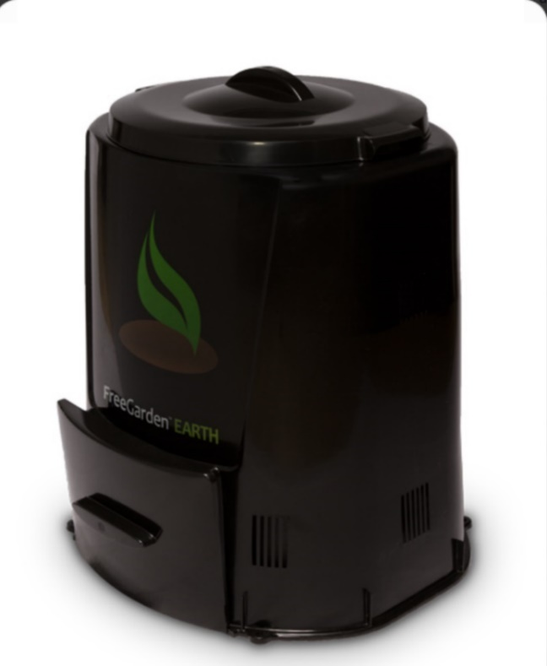
FreeGarden EARTH
The bin regulates the environment.
No assembly required
(Enviro World Corporation, 2009)

Slide 6
Getting started
DO add: Green organic materials & Brown organic materials.
Fruit & vegetable scraps
Yard leaves/twigs
DO NOT add: Dairy, meat, pesticide treated yard materials
Collect items to place in compost bin.
Add items & water to bin
Rotate contents of bin
With time, humus will form.

Slide 7
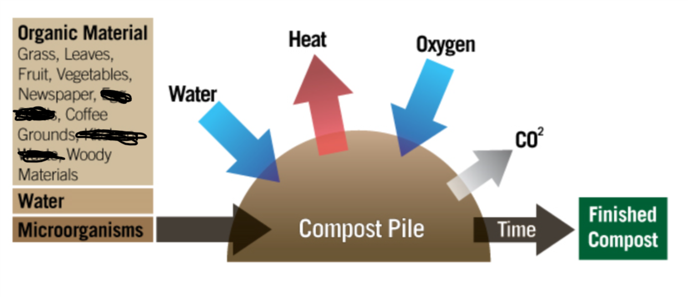
Variables to consider
There are 5 key areas to consider.
*This graphic is highlighting the process of how compost grows. Although the original source is unknown, Guerrero uses this graphic in “Crop Talk: 6 Steps to a Thriving Compost Pile” (2014).

Slide 8
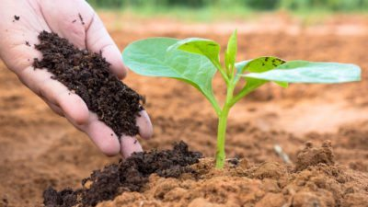
The final product
Dark, earthy-smelling, crumbles
Apply to gardening/planting
Enriches soil
(Pierce, 2017)

