Slide 1
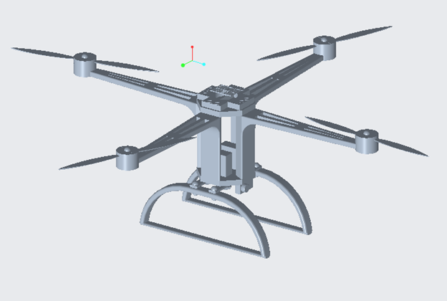
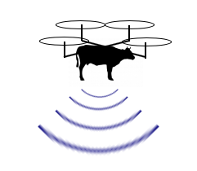
Rapid Response Communications Recovery with C.O.W.s
Flying COW, LLC
David Geiger,Yang He, Frank Orefice, Hanane Sobhi

Slide 2
Introduction
Due to the devastation caused by Hurricane Maria, cellular communications infrastructure in Puerto Rico was crippled.
Residents, local governments and even emergency responders were left without the ability to communicate for long periods of time.
The damage was so severe that “91% of Puerto Rico was left without cell phone coverage, cutting off a lifeline to family and first responders” (Weise, 2017).

Slide 3
Background
Mobile carriers such as T-Mobile, Sprint and AT&T, despite being competitors, worked together “to provide communication to people in despair” (Rogers, 2017).
To lessen the impact, mobile carriers have sent supplies such as VSATS (Very Small Aperture Terminal) and Cell On Wheels (COW), which are mobile cellular sites.
Due to the destroyed infrastructure, the Cell on Wheels utilized by the mobile providers has had trouble traversing the island to help those who have been hindered by the storm.

Slide 4
Background
To overcome these limitations, AT&T has since developed Cell On Wings, which is a drone that contains a small cell antenna and is able to cover more areas to provide people with coverage.
Though AT&T has proven that this new technology works, it hasn’t used it in Puerto Rico since it was first unveiled (Wamsley, 2017).
If more mobile providers were able to utilize this technology it will lessen the effects of natural disasters and help increase recovery time.

Slide 5
Our Solution
We will mass produce Flying COWs based on the ones used by AT&T during the aftermath of Hurricane Maria in Puerto Rico.
Due to the usefulness of the device and the number of users it could reach, it would be able to greatly help those who were impacted by natural disasters.
Devices such as VSATS and Cell on Wheels are inefficient compared to the Cell On Wings, as the Cell On Wheels are unable to traverse areas due to destroyed roads, downed power lines and down bridges.

Slide 6
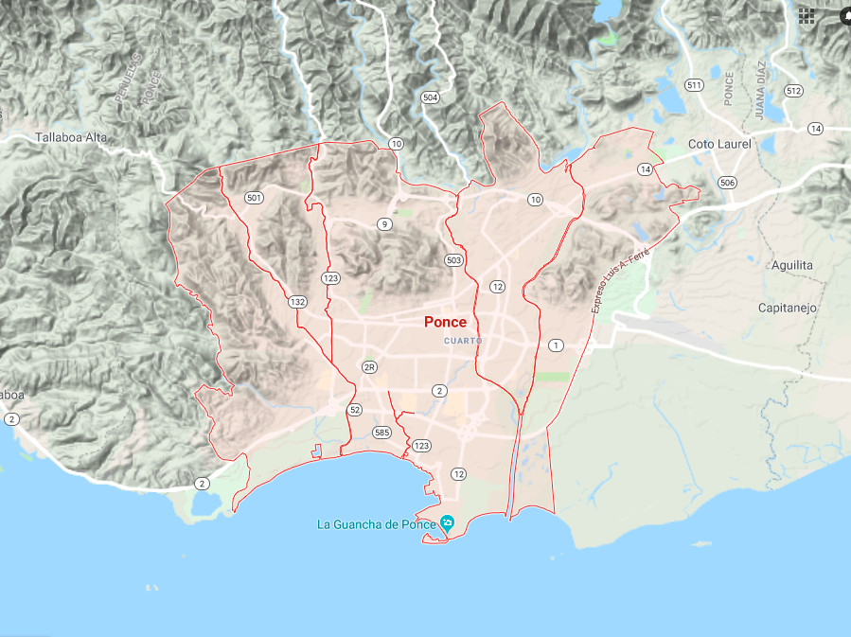
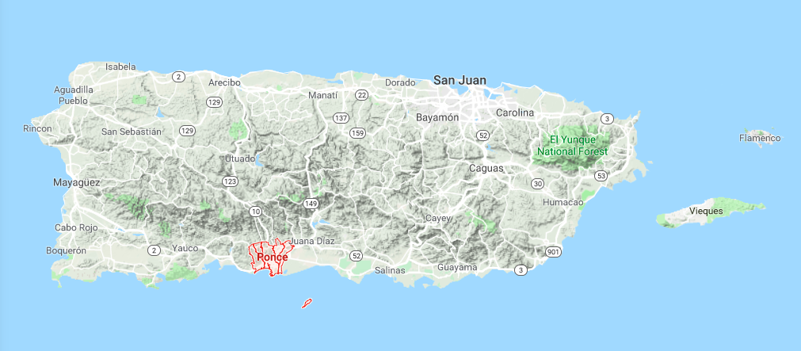
Proof of Concept
Ponce, Puerto Rico

Slide 7
Objective
Our team hopes develop efficient and cost effective Flying COWS for the government, mobile providers and humanitarian organization to help areas affected by the loss of cellular towers during natural disasters.
We first plan to test our drones in Ponce Puerto Rico, a coastal area that was devastated by Hurricane Maria.
These Flying COWs will be deployed in the affected area to allow people to have mobile access to communicate with their loved ones.
In doing this, the team hopes to help those in need by connecting them with others when they need it the most.

Slide 8
Design
The drone is a four-axis aircraft, which is a multi-axis aircraft with four rotors to hover, maintain posture and level flight.
The drone is small in size, light in weight, and easy to carry, it can easily enter various harsh environments where people cannot easily enter.

Slide 9
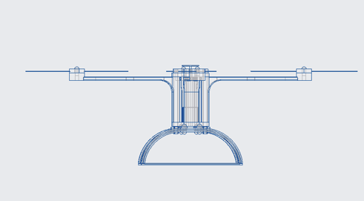
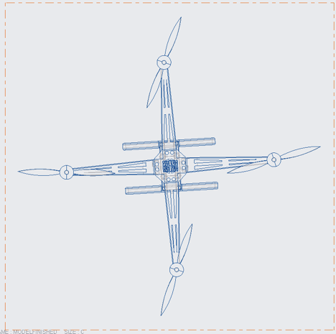
Drone Design

Slide 10
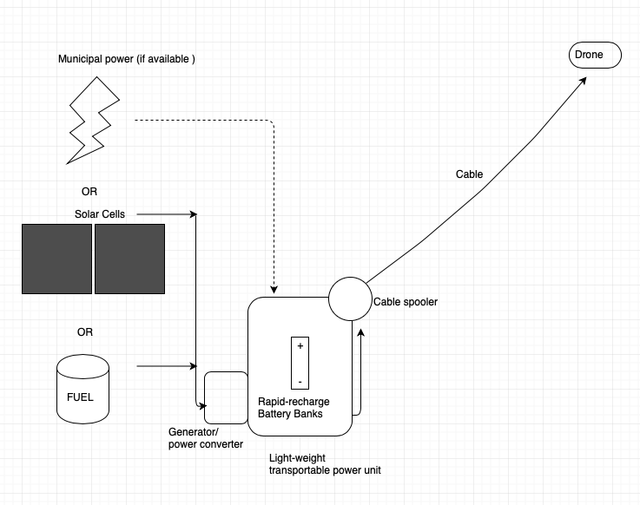
Base Station Design
The drone will be power by a mobile base station that can supply up to 5 days of power via gas generators and solar panels.
They are enclosed in a polycarbonate/ aluminum severe weather resistant case.
The transmission cable connects the base station to the drone to supply power and communications.

Slide 11
Schedule and Cost
The project will begin in 1/1/2019 and is projected to end on 7/14/2020
Over the course of the projects lifetime, the drone will be developed and eventually tested in Ponce, Puerto Rico.
The project is planned to last a year and a half and cost about $1,796,854.00.

Slide 12
Conclusion
Communication is a vital part of society. Every day we communicate, either be it in-person, over the phone or on the internet.
However, due to our reliance on our mobile devices to communicate with others, if we were to lose access to them, we will ultimately lose our means of communication.
By developing the Flying COWs, people will be able to contact their loved ones and let them know that they are safe in the case of a natural disaster.

Slide 13
References
FCC. (2018). Human Exposure to Radio Frequency Fields: Guidelines for Cellular Antenna Sites. Retrieved from https://www.fcc.gov/consumers/guides/human-exposure-radio-frequency-fields-guidelines-cellular-and-pcs-sites
Rogers, A. (2017). In Puerto Rico, no power means no telecommunications. Retrieved from https://www.wired.com/story/in-puerto-rico-no-power-means-no-telecommunications/
Wamsley, L. (2017). FAA Approves Drone As ‘Cell Phone Tower In The Sky’ For Puerto Rico. Retrieved from https://www.npr.org/sections/thetwo-way/2017/11/17/564879549/faa-approves-drone-as-cell-phone-tower-in-the-sky-for-puerto-rico
Weise, E. (2017). Puerto Rico is nearly entirely cut off from cellphone service, leading to low tech solutions. Retrieved from https://www.usatoday.com/story/tech/2017/09/28/puerto-rico-cell-phone-service-tmobile-att-hurricane/710775001/

