Slide 1
Flood Free Farms
Courtni Holness
Caroline Schwab
Trent Strachan
Erin Wengerter

Slide 2
Qualifications of the Team

Slide 3
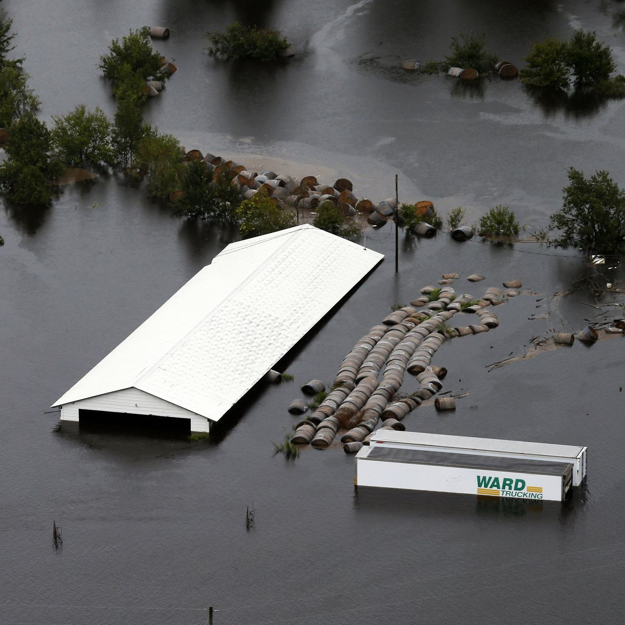
Introduction
Flooding of farmland
Loss of livestock
Weak structures
Water contamination occurs affecting health of residents
Notes:
Major flooding throughout North Carolina from Hurricane Florence especially in Duplin County.
Loss of livestock due to no adequate system in place to move the water from farms to the large water bodies.
The drinking water was contaminated.

Slide 4
Drainage System
What is needed?
Source of funding
Test site
Notes:
We propose to build an efficient drainage system.
We are asking for a test site and funding from the North Carolina government to install our system in Duplin County and if successful, install the system throughout North Carolina.

Slide 5
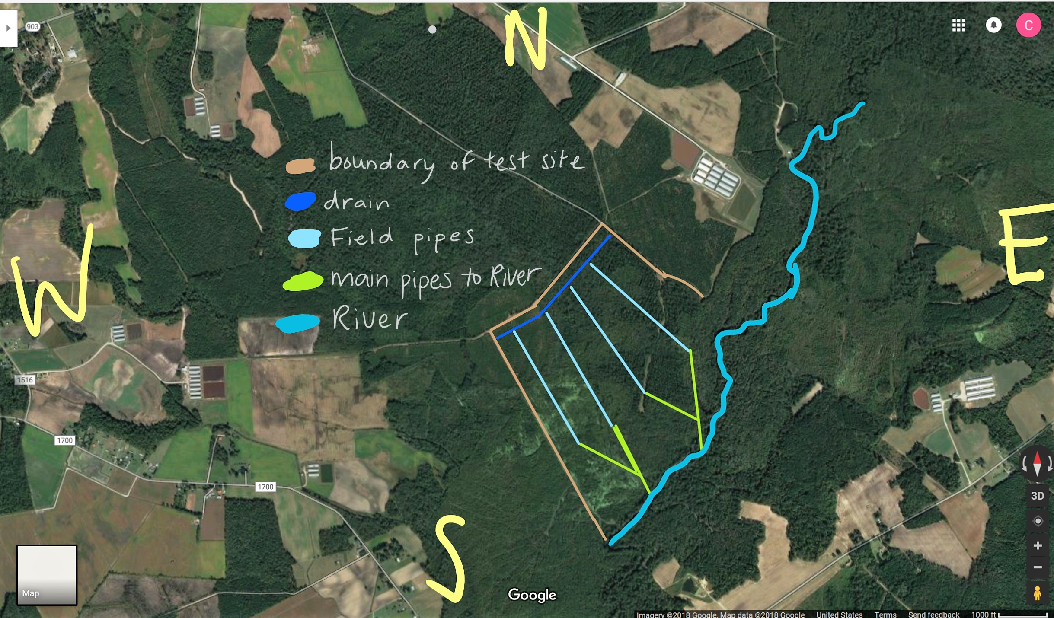
Technical Approach
3.03 by 2.65 mile area in Duplin County North Carolina.
System of drains and pipes traveling from livestock farms to a designated discharge space.
Topography
For the test the discharge area is the Northeast Cape Fear River
Notes:
Design is specifically to reroute flood waters.
The topography of NC follows a gradient moving from W to E.
Gravity will do the work, no pumps necessary.

Slide 6
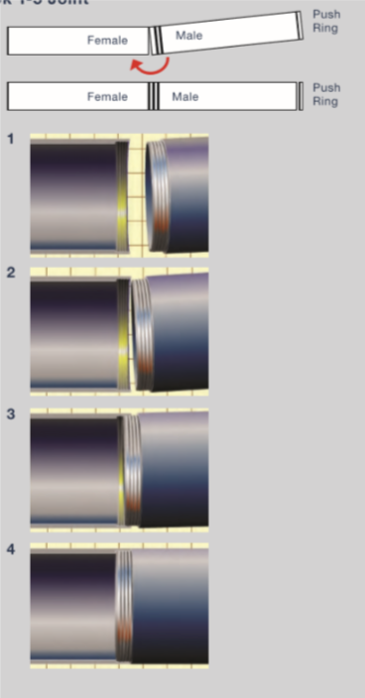
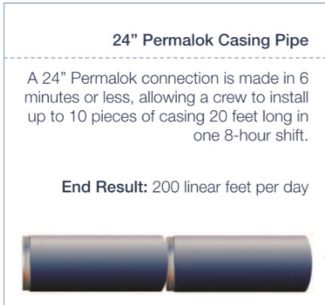
Technical Description
Permalok Steel Casing Pipes
No field butt welding required
Connected with Male/Female joints
(A Northwest Piping Company, 2018)
High efficiency saves time & money
Notes:
Reduces cost because of its efficiency.
No need for Field Butt welding as is the case with with traditional case piping
Quick Easy Installation
Leak Proof Under considerable groundwater pressures
We chose this piping also because it can withstand a large temperature range
Designed to handle various types of loading conditions

Slide 7
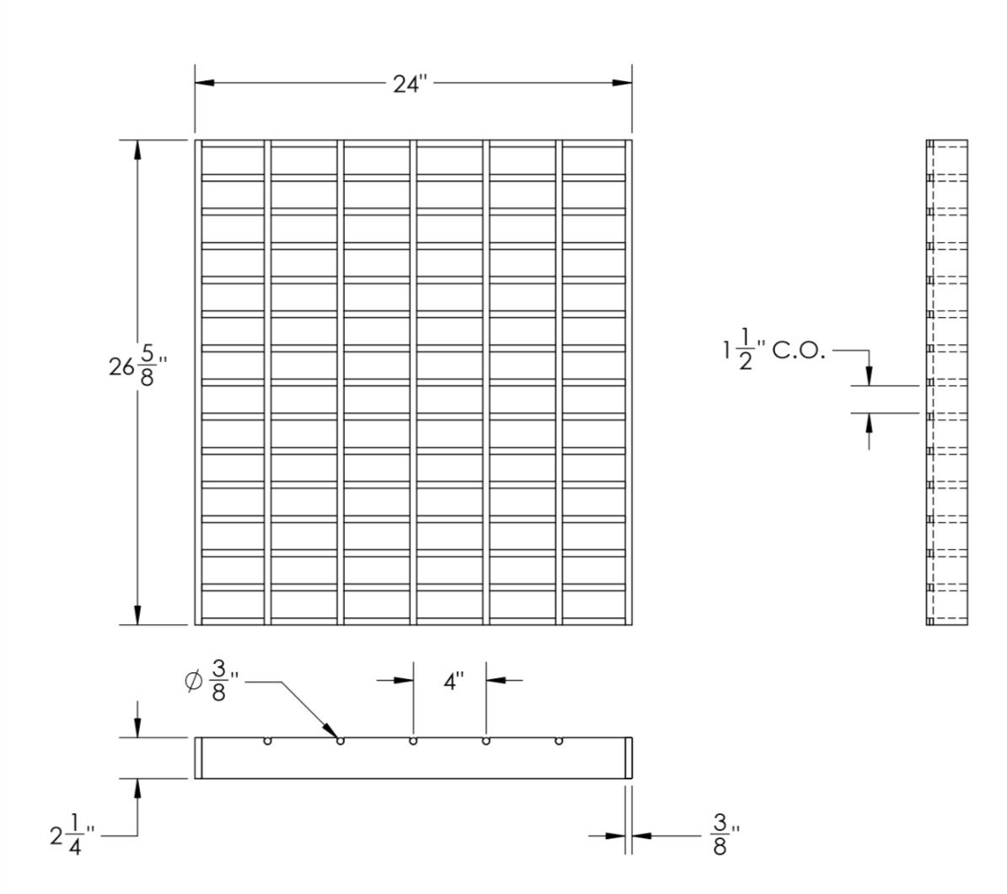
Technical Description
TechDrain Supply Drainage grate
110 pounds each
(TechDrain Supply, 2011)
Notes:
Made from Steel
Allow water to travel to underground pipeline system

Slide 8
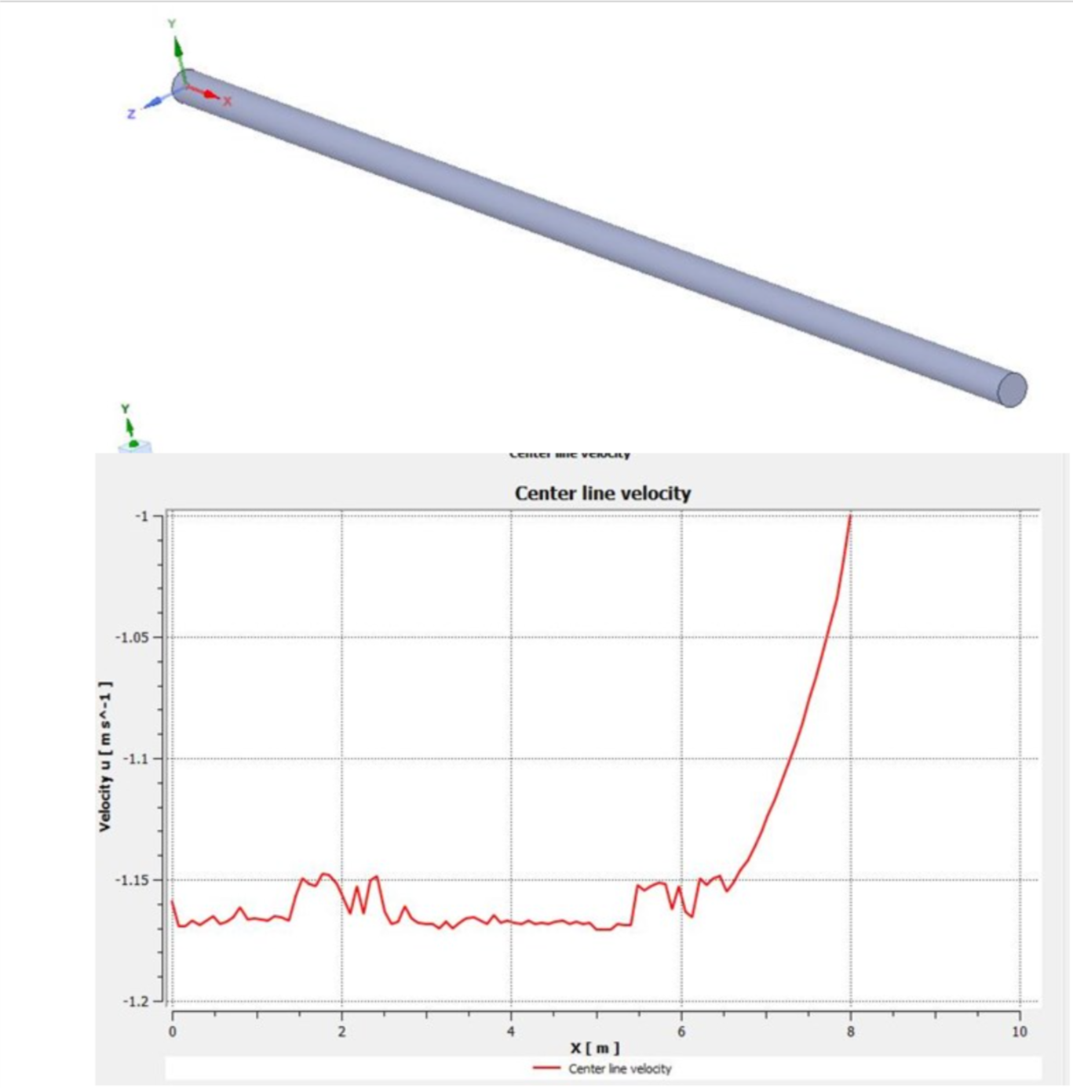
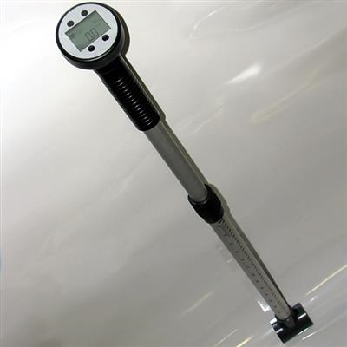
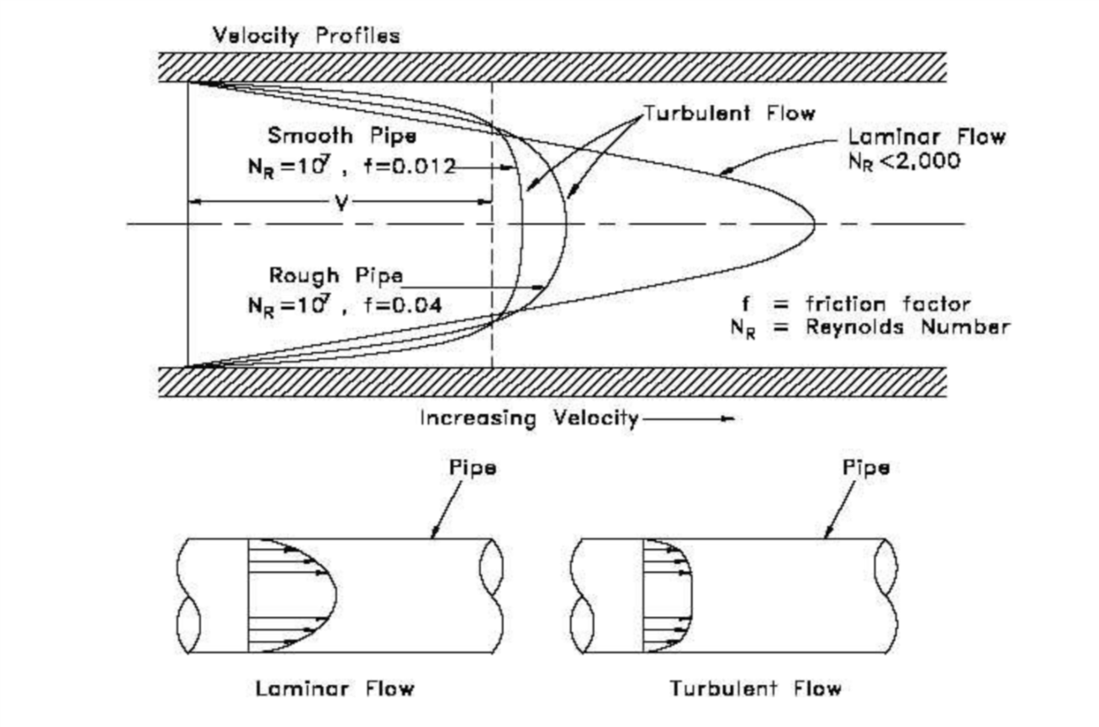
Technical Description
Global Water Probe flow probe
30 memory spaces, each stores a minimum, maximum, average velocity.
Water proof
(Global Water Probe, 2015)
ANSYS computational Fluid Dynamics program
Input data from flow probes
Useful for simulation
(ANSYS, 2018)
Notes:
High accuracy
Civil Engineer certified
LCD glare proof UV protection screen
Placed in inlet and outlet of pipe for measurements
ANSYS simulation can help us create disastourous scenarios with different condtions
These simulations can provide information for any adjustments that may be needed.

Slide 9
Quality Assurance Plan
Risks
System Integrity
Overflow
Weathering
Damage
Water contamination
Prevention
Routine pipe inspection
Fluid mechanics

Slide 10
Expected Project Results
If test is successful, and rainy season does not inundate land, and the system is applied across the state
Reduction of farmland flooding
Reduction of livestock death
Economic benefit for farms
Better quality, sustainability of land

Slide 11
Schedule
Gantt Chart Schedule of the 8 step project split between 3 phases in 6 months (Oil and Gas Pipeline Construction: Step-By-Step Visual Guide, n.d.).
Notes:
Make sure the route we are digging is not going to hit any underground obstruction
In order to construct a pipeline, staging areas and storage yards are cleared, strategically located along the planned right-of-way.
After the equipment is accessible in the staging area, work will begin to clear cut the pipeline right-of-way.
The trench for the pipeline is dug after the ROW is cleared of trees.

Slide 12
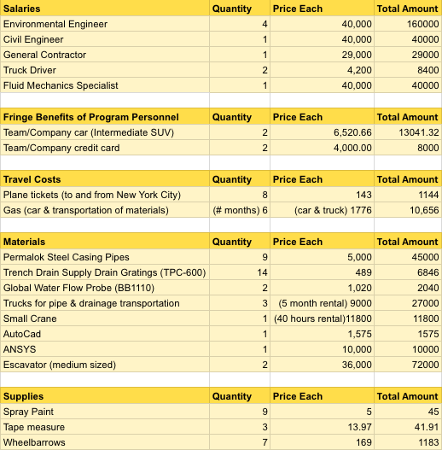
Budget (Direct Costs)
Salaries Total = $277,400.00
Fringe Benefits of Program Personnel Total = $21,041.32
Travel Costs Total = $11,800.00
Materials Total = $176,261.00
Supplies Total = $1,269.91
Overall Total = $456,272.23
The budget breakdown in their respective sections (Anastasios, 2018).
Notes:
- INCLUDE FLUID MECHANICS SPECIALIST
- INCLUDE INDIVIDUAL TOTALS

Slide 13
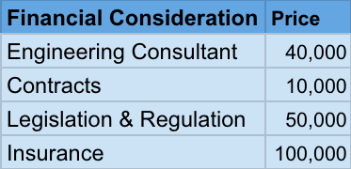
Budget (Indirect Costs)
The calculation is based upon the fact that there are financial burdens that are likely to come into play during the project without necessarily being a part of the project itself.
Overall Total = $200,000

Slide 14
Conclusion
What are we asking for?
To receive funding from the state of North Carolina on this project
To receive the test site proposed or a possible alternative with similar topography/qualities
Thank you!
Notes:
-asking for money and a test site

Slide 15
References
A Northwest Pipe Company. (2018). Permalok Steel Casing Pipe. Retrieved from
https://www.nwpipe.com/product/permalok-steel-casing-pipe/
Anastasios, A. K. (2018, October 11). Construction Project Management Processes: Everything
You Need to Know. Retrieved from
https://geniebelt.com/blog/construction-project-management-processes
Consulting fee rates | Consultant fees. Consultant Journal. (2017, December 18). Retrieved from
http://consultantjournal.com/blog/setting-consulting-fee-rates
Global Water. (2015). Global Water Flow Probe. Retrieved from http://www.globalw.com/products/flowprobe.html
Helber, S. (2018). Florence Flooding hits North Carolina Hog Farms Hard. Retrieved from
https://www.wsj.com/articles/florence-flooding-hits-north-carolina-hog-farms-hard-1537398585
Oil and Gas Pipeline Construction: Step-By-Step Visual Guide. FRACTRACKER. (n.d.).
Retrieved from
https://www.fractracker.org/resources/oil-and-gas-101/pipeline-construction/
Trench Drain Supply. (2011). 24” Wide Trench Drain Steel Grate. Retrieved from
https://www.trenchdrainsupply.com/prodimages/submittals/EJ2/NCR11-0775%20Grate.pdf

