Slide 1
The Powerpoint on Powerpoints
Building a presentation

Slide 2
Students will be able to…
Critically analyze and edit their own papers and extract relevant content for use in an oral presentation (powerpoint)
Construct a well structured powerpoint
Consider the rhetorical situation for a powerpoint.
How is it different from the rhetorical situation for a paper essay?

Slide 3
Rhetorical situation
How, if at all, does the rhetorical situation change when you change the media?

Slide 4
Four basic types of presentations
Impromptu
Extemporaneous*
Scripted*
Memorized

Slide 5
What are the advantage of oral presentation?
It encourages and enables dialogue between speaker and audience!
Removes the wall/separation between the two sides.

Slide 6
What are the challenges of oral presentation?
Listeners can’t reread something they didn’t understand.
Maintaining audience attention.

Slide 7
Considering Audience
Five types of audiences
Clients and customers
Colleagues in your organization
Fellow professionals at a conference
Government Agencies
The public
This could be anyone (unknown)

Slide 8
How does analysis of audience and purpose affect the content and form of your presentation?
What do you need to know about your audience?
Audience analysis
What is the purpose of your presentation?

Slide 9
Powerpoints need…
Clear structure/ORGANIZATION
Introduction- might forecast the central parts of your lecture (Markel 581)
Text/Body- focus on main points
Data, graphics, audio/video, props
Method of presentation
Cause and Effect
Problem-method-solution
Transitions to segue between topics
Conclusion- something memorable, perhaps places topic in a larger context, gives audience something to consider (Markel 581-582)

Slide 10
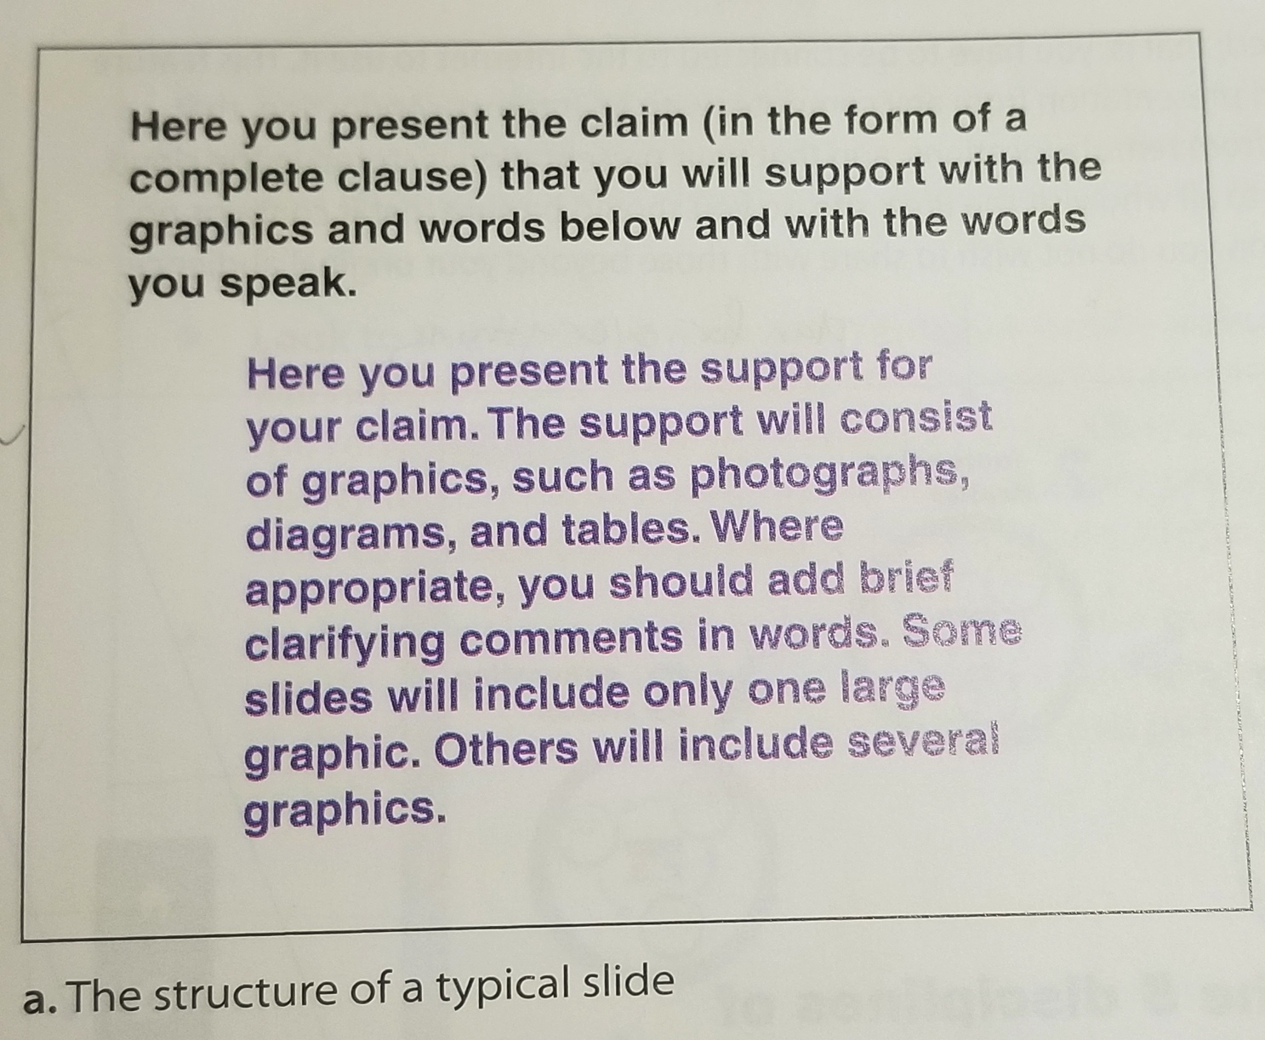
Slide Construction
Presents a Clear and Well supported slide
It is easy to see
It is easy to read
It Is simple
It is correct
Markel 584

Slide 11
Things to consider…
Draft work
Scripts
Budgeting your time
Rehearse!

Slide 12
Things to consider…
Presentation delivery
Speak clearly, slowly, and loud! Project your voice.
Try not to be stiff
Pause for emphasis and allowing the audience to catch up and process
Look at the entire audience

Slide 13
Things to consider…
The presentation of the presentation
Font color and size
Try to avoid paragraphs, use lists
Clear photos
Animation
Don’t over overfill slides

