Slide 1
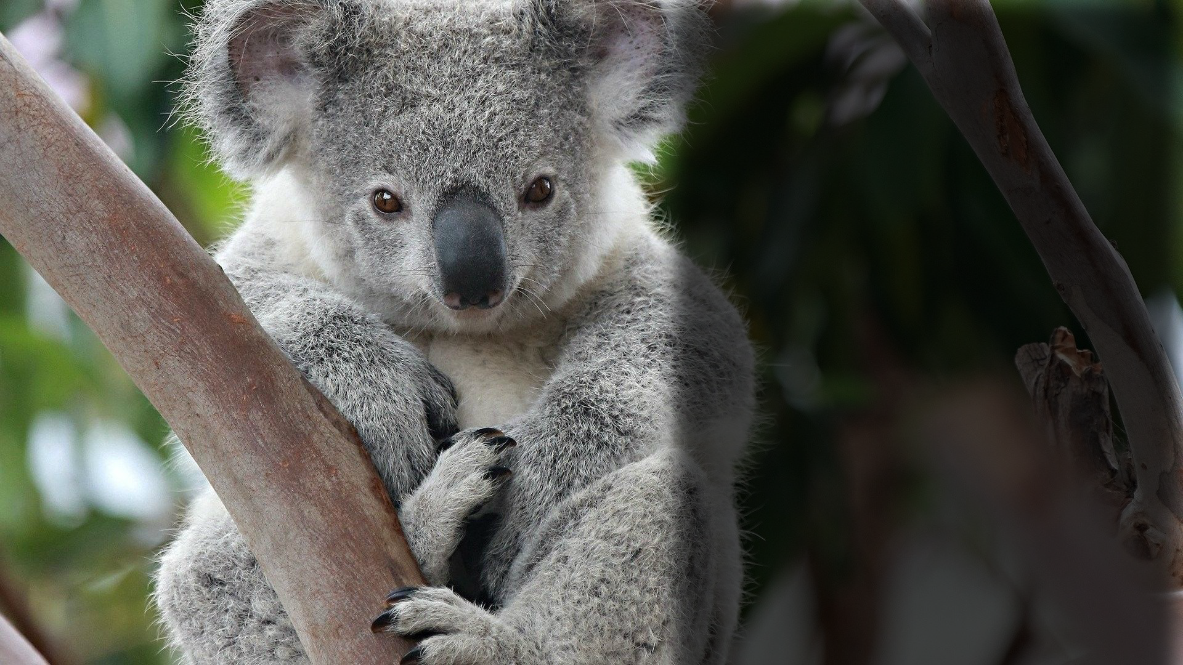
Wild Koala Rescue via
Temporary Habitats and Relocation
Ace Ventura Pet Detective Corp.
Edison Menendez, Jose Zamora, Michael Bartsevich, Patryk Strugacz

Slide 2
Background
Humans are negatively impacting the environment with global warming, causing wildfires to be increasingly common.
In recent years, Australia has had over 46 million hectares of land destroyed in wildfires.
Koalas are currently an endangered species in Australia and are threatened by these bushfires.

Slide 3
Introduction
The most recent wildfires began in June of 2019 and the worst of it lasted until February 2020.
At least 30 human deaths, 500 million animal deaths and $1billion in damages
Australian volunteers, police and military are working to curb the spread of the wildfires.
Organizations such as Irwin Family, helped over 90,000 animals by providing medical attention and refuge in zoos (Elassar, 2020).

Slide 4
Need Statement
We seek funding for the construction of portable shelters that will house koalas.
These shelters will comply with the guidelines put out by the Department for Environment and Water of the South Australian Government.

Slide 5
Objective
Rescue koalas and transport them to safe areas.
Build temporary enclosures to house the koalas.
Take care of the koalas while they live in the portable habitats.
Release the koalas back into the wild when the fires have passed, and the environment is relatively safe.
Observe the climate patterns and repeat this for as long as bushfires keep recurring

Slide 6
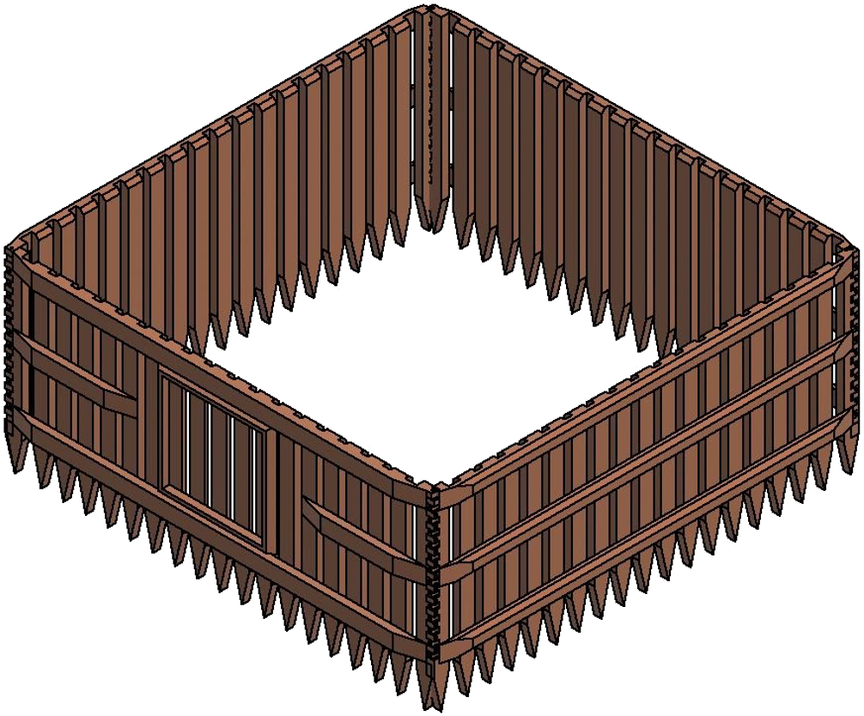
Our Idea

Slide 7
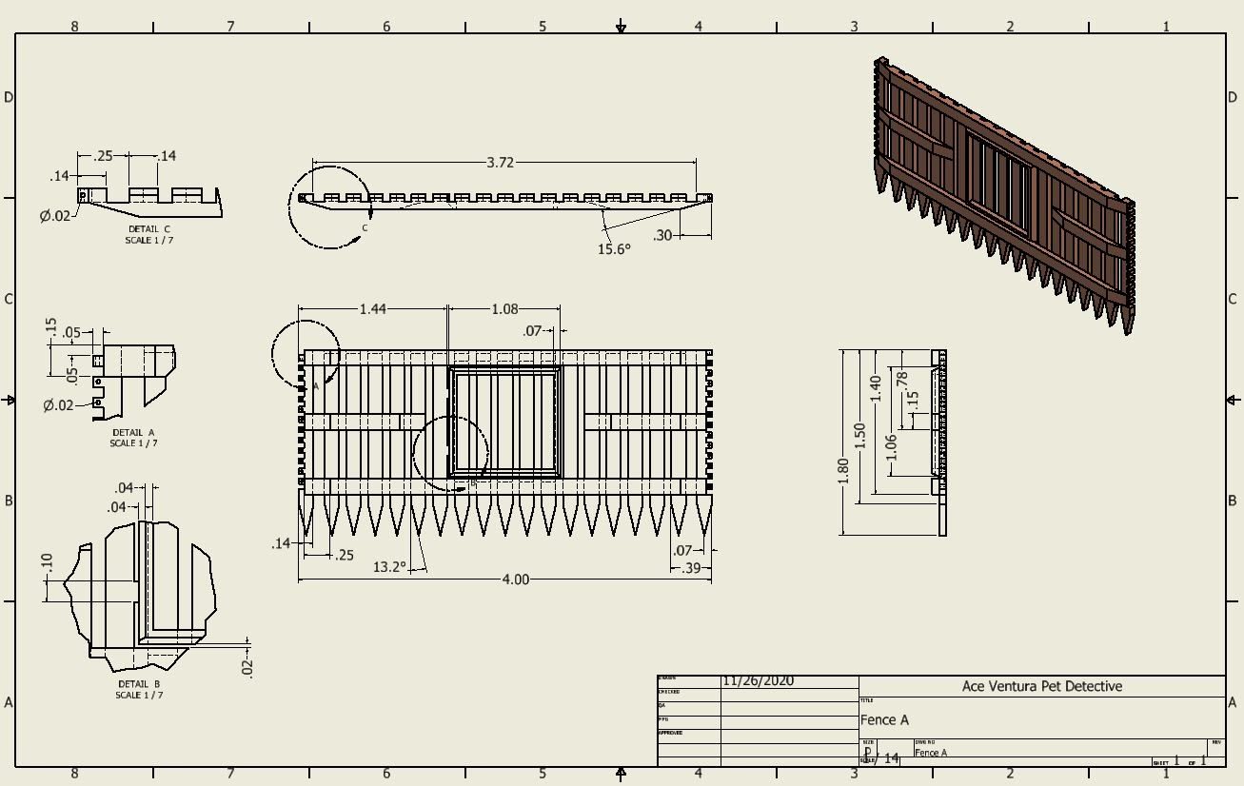
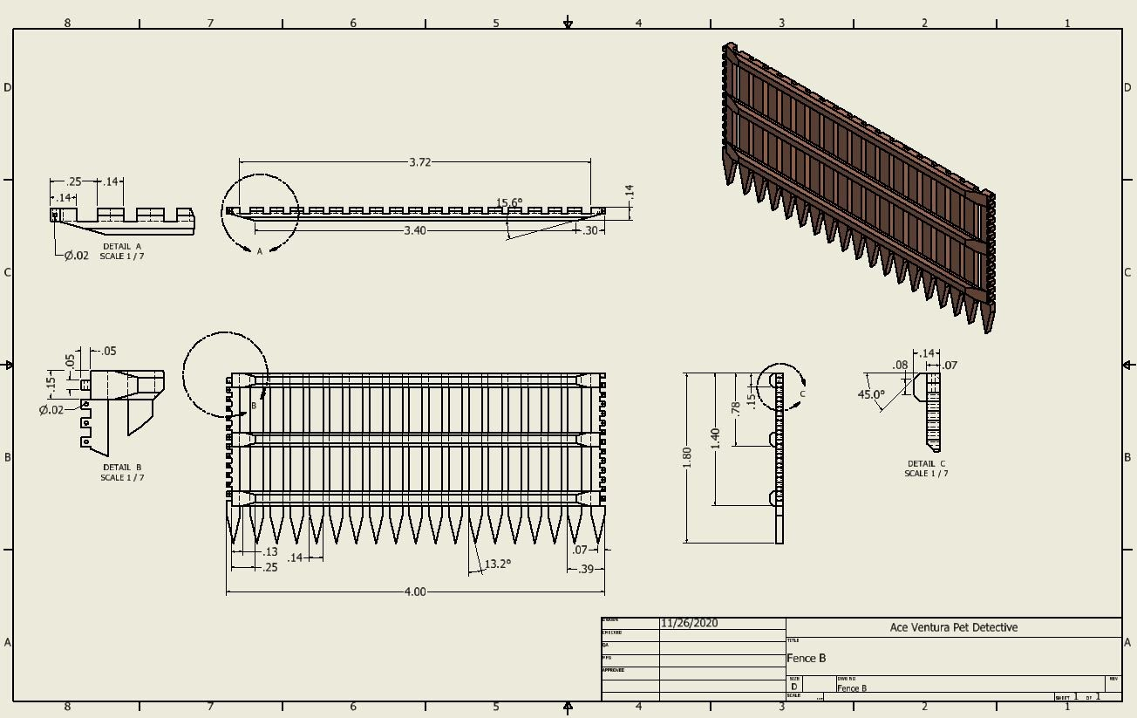
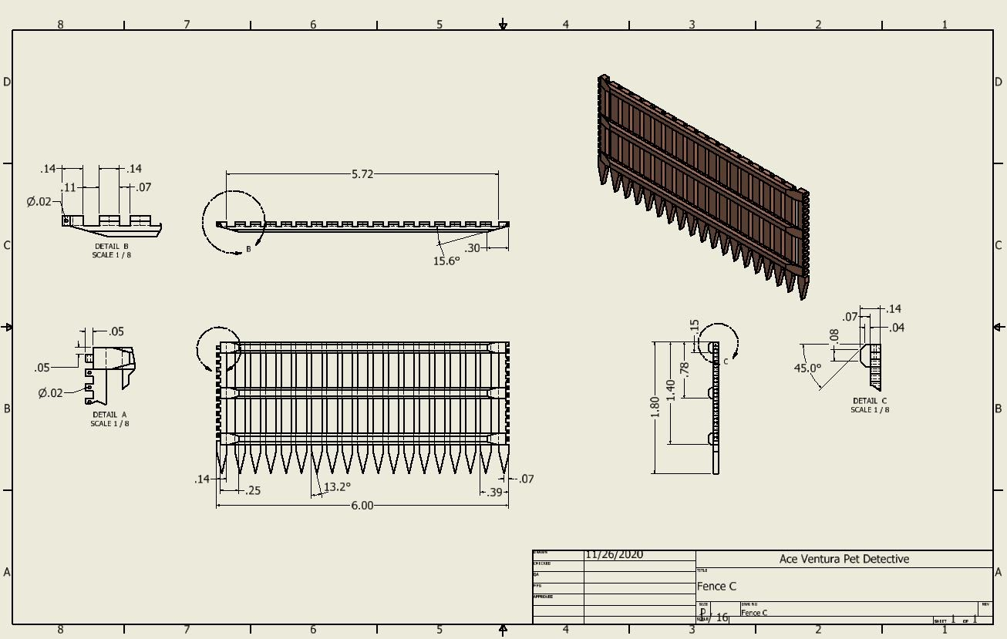
x2
Notes:
Mention how our design is made out of wood which may seem counterintuitive, but is is made out of all recycled wood, and the benefits it will bring will outweigh the concequences of using the small amount of wood that we will use.

Slide 8
Budget and Costs
Project Category | Labor | Materials | Total
Human Resources | $445,000.00 | $124,000.00 | $569,000.00
Traveling Spendings | $6,000.00 | $23,000.00 | $29,000.00
Training Fees | $4,000.00 | $1,700.00 | $5,700.00
Material Resources | $13,000.00 | $68,000.00 | $81,000.00
Professional Services | $68,000.00 | $14,000.00 | $82,000.00
Capital Expenditures | $13,000.00 | $47,000.00 | $60,000.00
Contingency Reserves | $82,670.00 |  | $82,670.00
Total |  |  | $909,370.00
Notes:
Specify that this budget is only for the first year of operation.
This budget incudes:
* Salaries of full and part time employees
* Cost of all materials and manufacturing necessary
* Travel costs of all team members+ meals and lodging
* conferences and workshop training
* Studies to support the project
* Legal advice through consultants
* All equiptment
* All insurance, contracts and regulation.
* Contingency funds

Slide 9
Schedule
Date | Task
01/01/2021 | Meet with Andrew Metcalfe, Executive of Australia's Department of Agriculture Water, and The Environment. This meeting will be conducted via zoom due to the current pandemic.
01/15/2021 | Travel to Australia to meet with representatives of Andrew Metcalfe and further discuss our proposal.
02/01/2021 | Visit veterinarian wildlife hospitals to meet with caretakers and specialists to have a better understanding of the situation that animals are facing regarding bushfires.
02/10/2021 | Travel to areas that have been affected by bushfires to study the habitats and gather more information.
02/15/2021 | Gather all materials and necessary tools to build the portable shelters.
03/01/2021 | Deploy first portable shelter and troubleshoot.
03/15/2021 | Visit an area with high risk of bushfire and capture a small amount of koalas to redeploy in portable shelters where they will be given medical attention and proper care.
04/01/2020 - 05/14/2020 | We expect to reintroduce koalas to safe areas between these dates; however, the date may vary for each koala.
05/15/2020 | After proving to be successful we will work on more areas and accept any and all koalas who may be suffering a loss of their home.

Slide 10
Quality Assurance Plan
Potential need for maintenance on the enclosures. Enclosures will be inspected each time before use to make sure there are no defects.
Wood enclosures are flammable. They will be sprayed with fire retardant.
Notes:
Enclosures are made out of wood so they can easily rot or break and may need maintenance

Slide 11
Measure of Success
The 2019-2020 bushfires killed over 5,000 koalas in New South Wales, which is in Southern Australia, according to reports from the Parliament, in collaboration with Biolink
After installing our program, we will be able to measure our success based on the report that will come out the following year.
If there is a decrease in the numbers, we can safely assume that our project had a positive effect on maintaining population numbers.

Slide 12
Conclusion
Due to global warming, humans have globally caused an increase in wildfires, endangering many different species of animals.
We ask for funding to develop and manufacture our portable Koala enclosures and fund rescue teams.
Notes:
After the second bullet, quickly explain why our portable design is better than the traditional zoo.
- say they comply by regulations and can easily be folded and transported.
- say that our operation aims to help those that cant fend for themselves.

Slide 13
References
Animals Matter. (2020). Facts - Wildlife. http://www.animalmatters.org/facts/wildlife/
Center for Disaster Philanthropy. (2019). 2019-2020 Australian Bushfires. https://disasterphilanthropy.org/disaster/2019-australian-wildfires/
DoSomethingEditors. (2020). 2020 Australian Bushfire Crisis. https://www.dosomething.org/us/articles/2020-australian-bushfire-crisis?&utm_source=twitter&utm_medium=social&utm_campaign=australian-bushfire-crisis
Elassar, A. (2020). The Irwin family is working to save the animals injured in the Australian Wildfire. CNN. https://www.cnn.com/2020/01/06/australia/irwin-family-australia-fire-full-circle-trnd/index.html
Glover, R. (2020). Seven months after the bushfires, Australia is still devastated. The Washington Post https://www.washingtonpost.com/opinions/2020/07/30/seven-months-after-bush-fires-australia-is-still-devastated/
Government of South Australia Department for Environment and Water. (2020). Guidelines for the captive management for Koalas in South Australia. https://www.environment.sa.gov.au/files/sharedassets/public/plants_and_animals/pa-gen-koalaguidelines.pdf?BestBetMatch=koalas|720cd45f-5fec-4627-9f29-24303b5b894c|1771538a-419d-4c71-bd57-9e0e00fd8c25
Granwal , L. (2020). Bushfires in Australia – Statistics and Facts. https://www.statista.com/topics/6125/bushfires-in-australia/
Howard, B. C. (2019). First mammal species recognized as extinct due to climate change. National Geographic. https://www.nationalgeographic.com/news/2016/06/first-mammal-extinct-climate-change-bramble-cay-melomys/#close
Theguardian. (2013). History of Australian bushfires:interactive. https://www.theguardian.com/news/datablog/interactive/2013/dec/01/history-bushfires-australia-interactive

