Slide 1
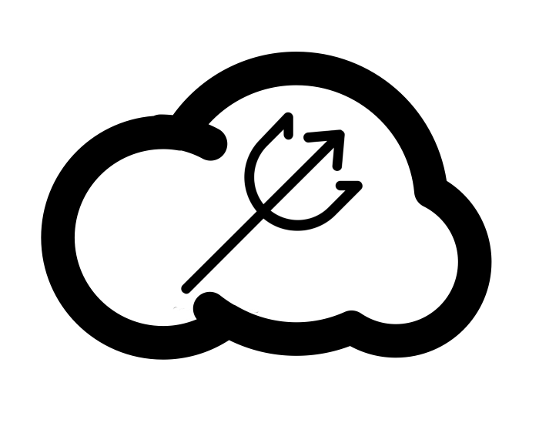
The Atlantis Cloud
Storage Project
Atlantis Prevention Inc.
(Borelle Fabrice, Omar Johnson, Citlaly Norales, Seth Pine, Kendrick Roy)

Slide 2
Agenda
Introduction
Architecture
Implementation Design
Expected Project Results
Budget
Schedule
Contact Us

Slide 3
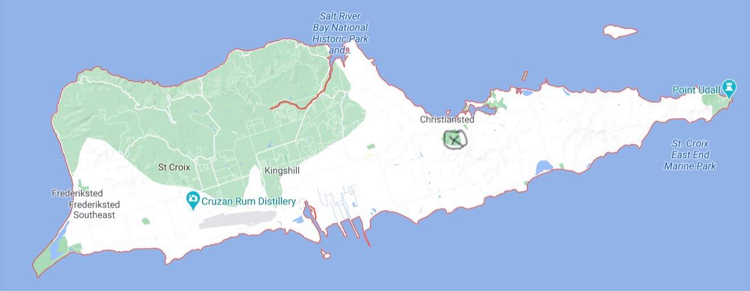
St. Croix, The U.S. Virgin Islands

Slide 4
Background
Alert VI Warning System
Offered voluntarily to residents
Virgin Islands Territorial Emergency Management Authority
Gives emergency tips and guidelines

Slide 5
Objective
Construct a Data Center
System sends reminders to backup files
Hope to provide a feeling of togetherness

Slide 6
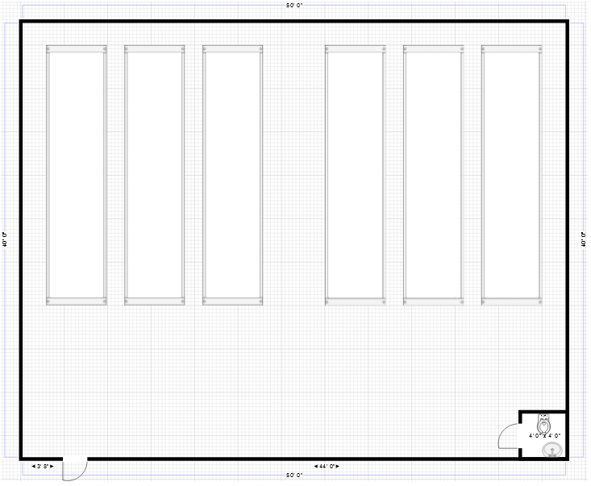
Architecture Design - Data Center

Slide 7
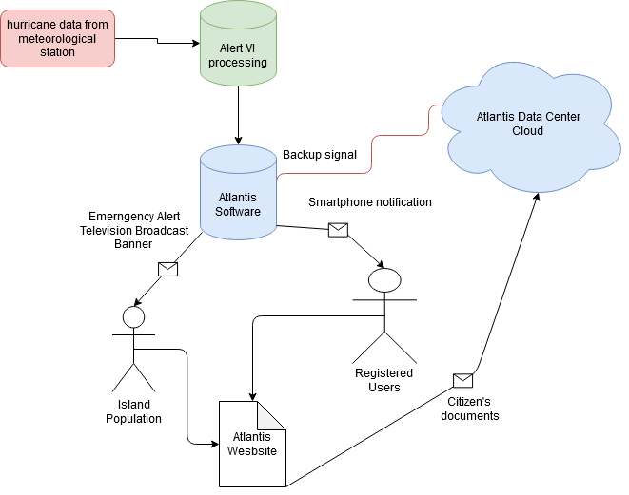
Architecture Design - Software

Slide 8
Implementation Design
Implementation design is split into three phases:
Phase 1: Infrastructure
Phase 2: Software Development
Phase 3: Education

Slide 9
Phase 1: Infrastructure
Data center will be built
Assembled by a subcontractor
Have a biodiesel generator and methane bioreactor
200ft² with a single bathroom
House 6 server racks
Total storage capacity of 46.8 Pb
Becomes responsibility of the U.S. Virgin Islands

Slide 10
Phase 2: Software Development
Write software using Alert VI system
Ensure the servers are fully updated
Creation of a web platform
Hosts a .gov domain
Responsible for creation NOT maintenance or hosting

Slide 11
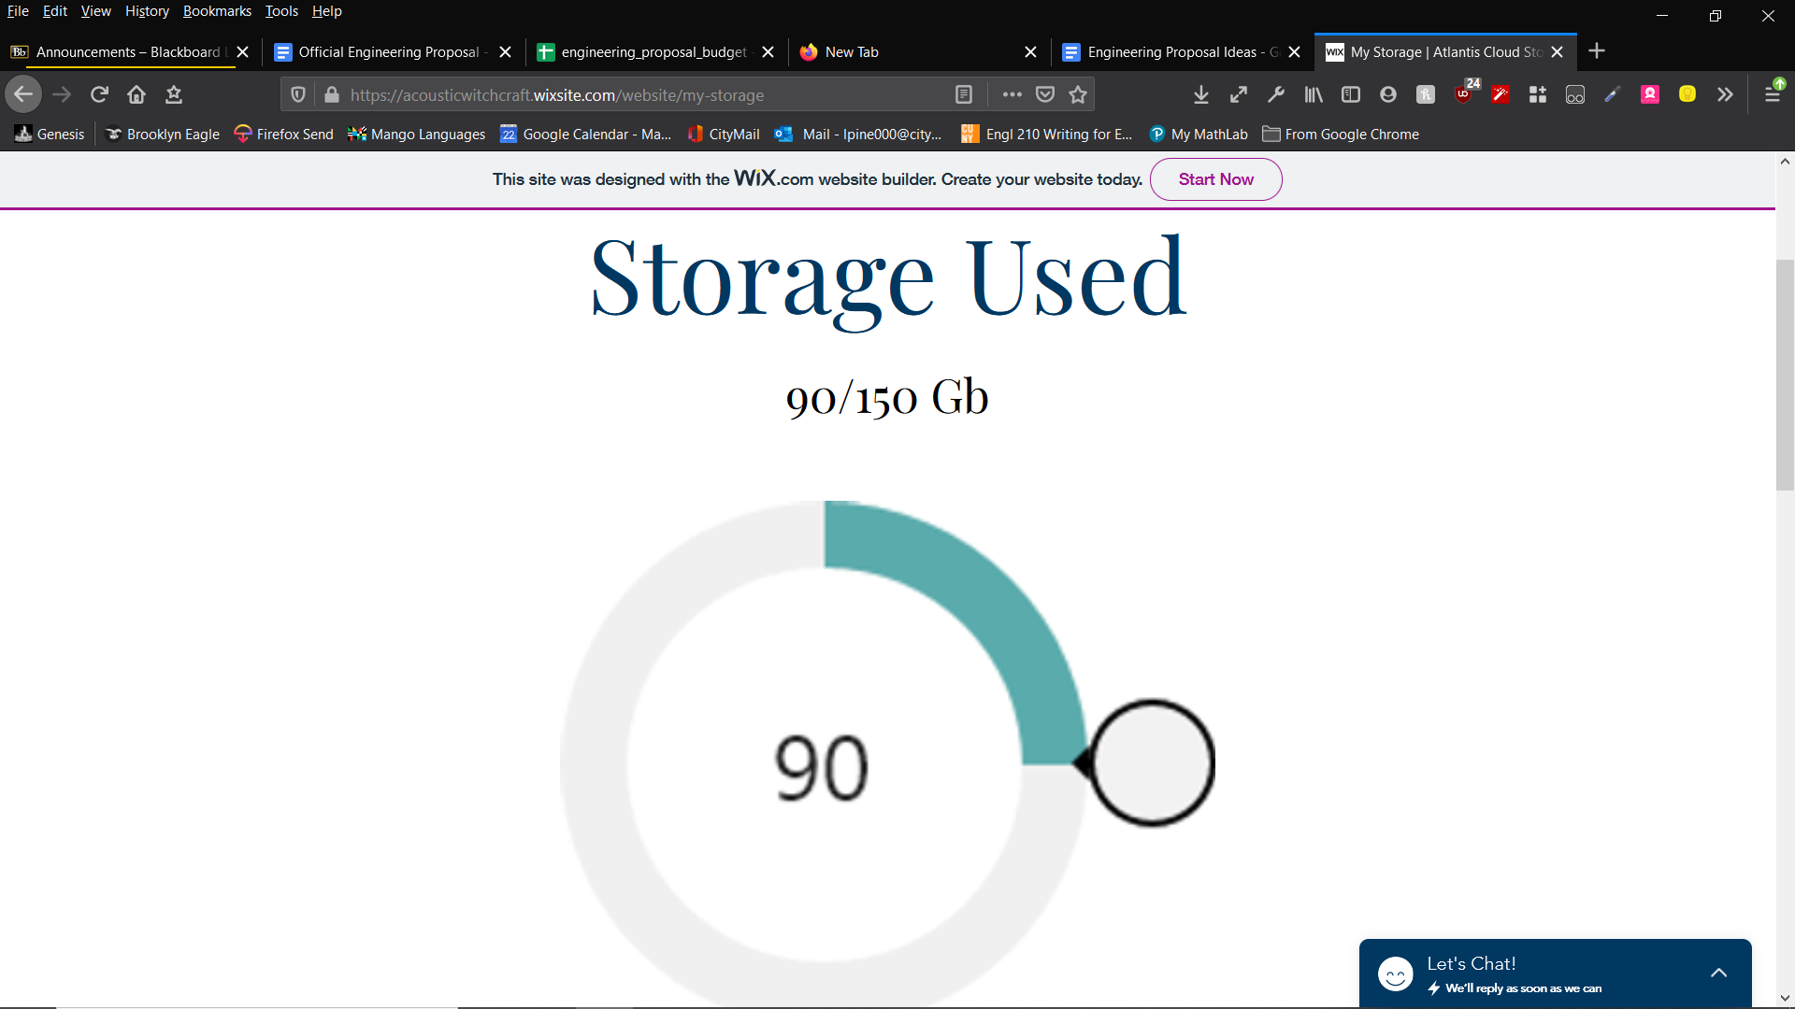
Phase 2: Software Development
Registered user’s document storage

Slide 12
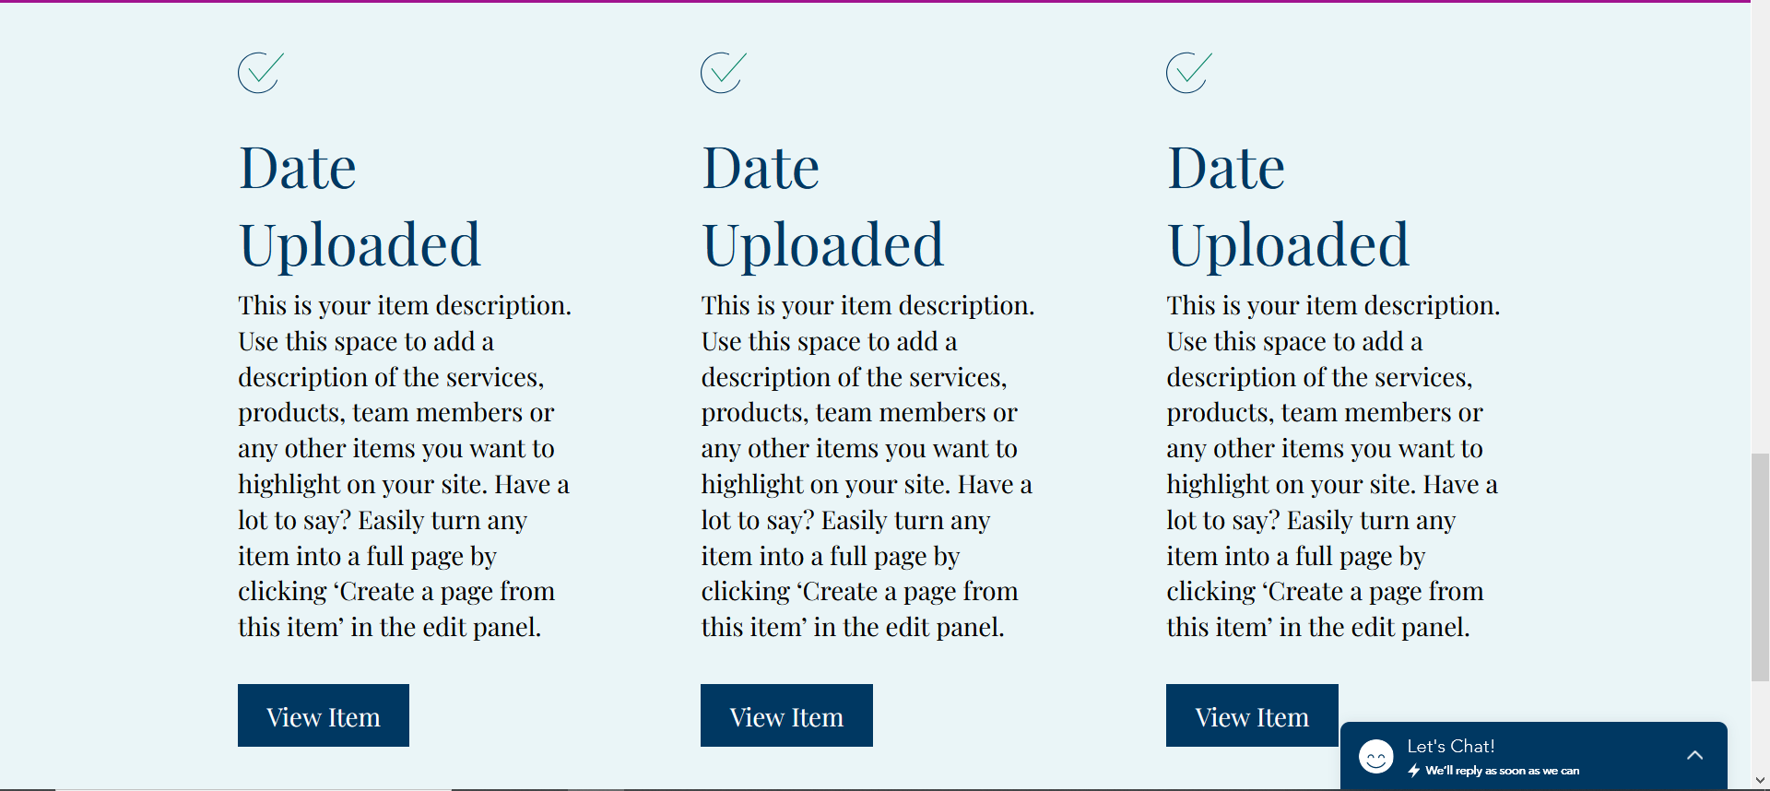
Phase 2: Software Development
Registered user’s document stored

Slide 13
Phase 3: Education
Working alongside local government to:
Inform IT departments and database managers
Formulate an advertising campaign

Slide 14
Expected Project Results
Finished when all objectives are met
Data center will be built
A new .gov website
Software to dent backup notifications
Give government full control of software

Slide 15
Measure of Success
Data center built on time
Government knows how it works
75% of the population registered

Slide 16
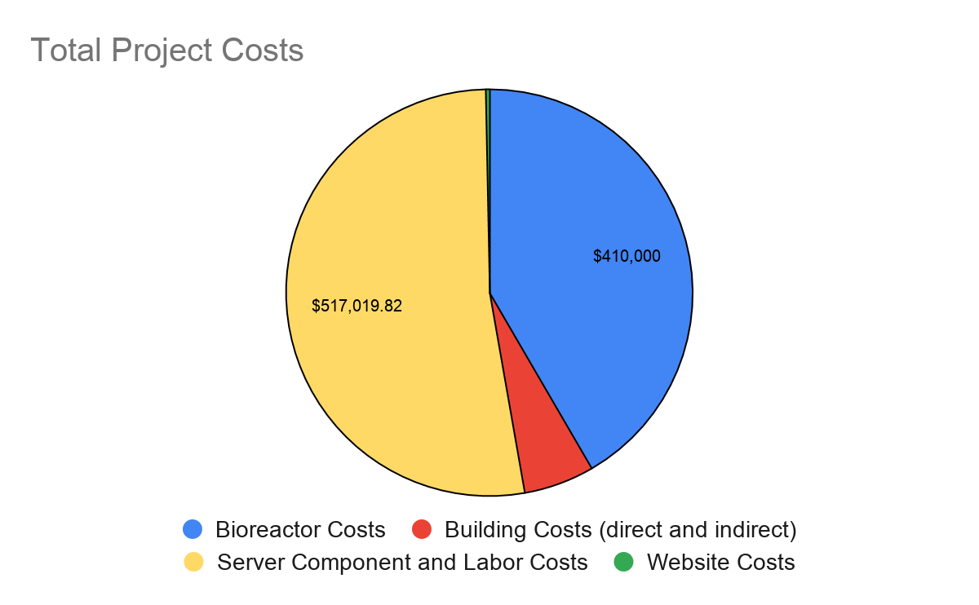
Budget

Slide 17
Schedule
Phase | Tasks | 3/1 | 3/8 | 3/15 | 3/22 | 3/29 | 4/5 | 4/12 | 4/19 | 4/26 | 5/3 | 5/10 | 5/17 | 5/24
I | level and pour foundation
 | mold and pour walls
 | cut in for wiring and plumbing
 | insulation and doorjambs
 | wiring and plumbing insulation
 | Reactor Installation
 | finishing
 | server assembly and connection
 | testing
II | website development
 | API development
 | database integration
III | information seminar

Slide 18
Contact Us
Feel free to contact us by visiting our company website, or by email:
roykendrick934@gmail.com
seth.pine@outlook.com
noralescitlaly@gmail.com

Slide 19
References
Unknown, (2020). Anaerobic Digesters.Exploring Energy Efficiency and Alternatives. Retrieved from;
https://www.e3a4u.info/energy-technologies/anaerobic-digesters/economics/#:~:text=General%20Cost%20Information&text=approximately%20%24400%2C000%20to%20%245%2C000%2C000%20depending,unit%20costs%20approximately%20%241.2%20million.
Government of The United States Virgin Islands, (2018). VITEMA.VITEMA. Retrieved from; http://www.vitema.vi.gov/
Source Staff, (2020, March 4). VITEMA Provides List of Emergency Alert System Device Manufacturers.The St. John Source. Retrieved from;
https://stjohnsource.com/2020/03/04/vitema-provides-list-of-emergency-alert-system-device-manufacturers/
XPERTECHS, (2012, April 25). How Much Does A Server Cost? XPERTECHs. Retrieved from;
https://www.xpertechs.com/2012/04/server- article/#:~:text=Businesses%20price%20out%20a%20server,%2C%20assuming%20straight%2Dline%20depreciation.
David C. Ekroth, (unknown). Building To Resist Hurricanes. Retrieved from; https://www.hsdl.org/?view&did=30117
Government of The United States Virgin Islands, (2014, March 10). Public Review Draft.
Retrieved from; http://www.chrishanley.com/wp-content/uploads/2014/05/Zoning-Consolidated_Public_Review_Draft031014.pdf
Department of Planning & Natural Resources, (2001, September 1).
Retrieved from; http://courses.washington.edu/onsite/Virgin%20Islands%20onsite%20sewage%20disposal.pdf

