Slide 1
Solar Generator for Hospital Metropolitano San Francisco
By Integrated Power Solutions
Performed by: Syed, Daniele, Heejin, Tiffany, and Macarous

Slide 2
Introduction
Due to the devastation caused by Hurricane Maria, 80% of Puerto Rico’s electrical grid was destroyed, leaving the island in total darkness
For hospitals, loss of power can be the difference between life and death because power is needed to to treat patients who needs medical attention, also, medical records of these patients need to be retrieved.
Residents, local governments and even emergency responders were left without the ability to communicate for a long period of time.
This engineering proposal is focused on the development of solar-powered generators that will allow hospitals to run independently in the event of an emergency.
This generator will first be tested in Hospital Metropolitano San Francisco and later distributed to other hospitals in the vicinity.

Slide 3
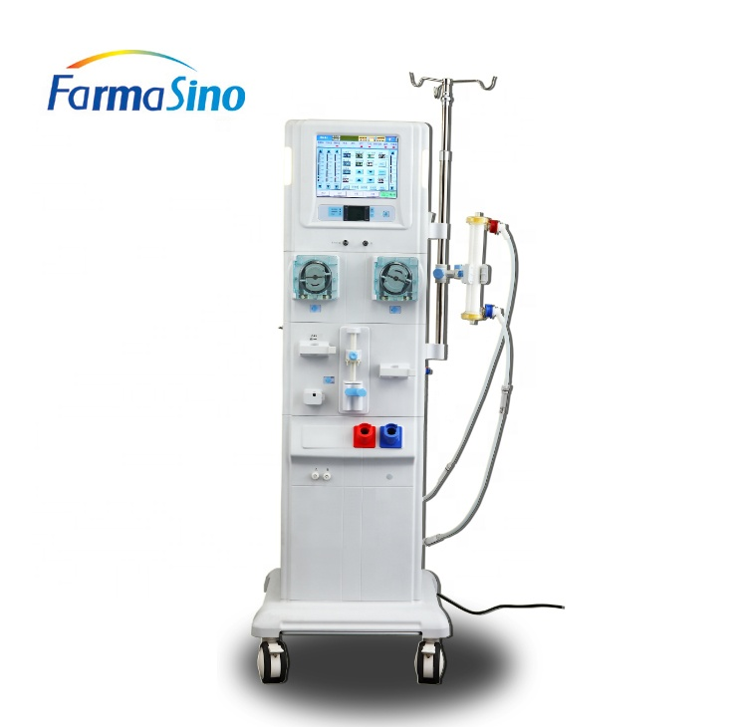
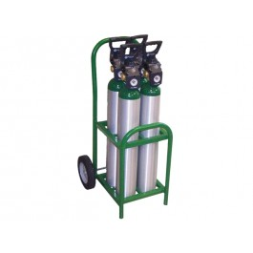
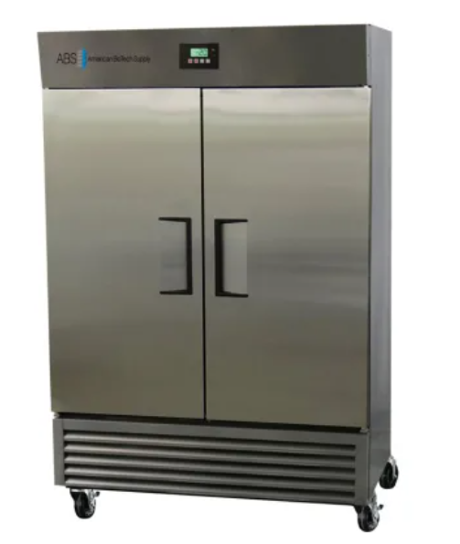
Hospitals Are Vulnerable to Blackouts
Hospitals are one of the largest electricity consumers
Backup generators are typically installed outdoor or in the basement
Fuel generators require a constant supply of fuels

Slide 4
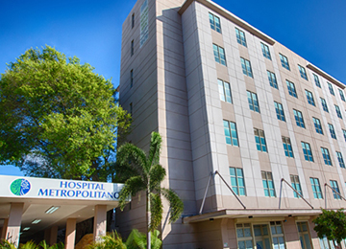
Objective
Seeking permission and funding to build the solar backup systems for Hospital Metropolitano San Francisco

Slide 5
Proposed Technical Approach
Integrated Power Solutions designed solar-powered generators to provide power to hospitals during disaster-based blackouts.
Solar panels will be securely mounted to the roofs of the buildings.
Generators will be positioned on the building’s upper floors to avoid damage from flooding.
The generators will run on a two battery system:
While one battery is being utilized, the solar panels will charge the other.

Slide 6
Proposed Technical Approach
Performance of the solar-powered generators will first be tested in specific wings of Hospital Metropolitano San Francisco
Once satisfactory performance is achieved, the generators’ load will be scaled to cover the entire hospital.
Integrated Power Solutions’ biomedical and electrical engineers will monitor the generators’ operation during the tests and for the following six months post installation.
After successful tests in Hospital Metropolitano San Francisco, generators can be implemented into hospitals across Puerto Rico.

Slide 7
Architecture Design
The main part of our system is the inverter that is connected to solar panels, the generator, and the power panel of the hospital.
The solar panel in our design used a glass coating and a 50% isotope of silicon-29 that would help with more absorption of sunlight.
The larger the isotope, the larger the atom’s nucleus, and when we have a larger atom, the atom loses electrons more easily.
This decreases the amount of energy needed by the silicon atom and increases the number of charged ions, which increases the output of the solar panels.
This will increase the solar panel output and charge generators quicker to decrease the amount of time needed to recharge them.
The quick recharging of generators would ensure the non stop supply of electricity day and night for weeks, or as long as the power outage lasts.

Slide 8
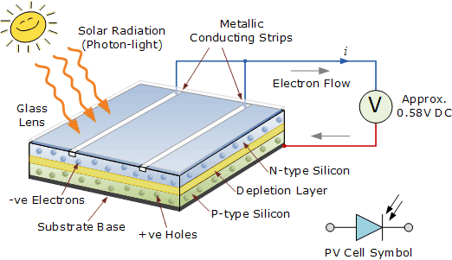
Solar Panel Design Image
.

Slide 9
Technical Description
As shown by the figure 1 solar solar panel is a type of transistor which has has three layers.
One that positively charged, one is negatively charged and the layer in the middle is a buffer zone. The 2 opposite charged layers create the voltage.
The negatively charged ions of silicone that travel from one side of the panel to the other creates a current, which travels through the wire.
The wire from solar panels is connected to the inverter.
The inverter contains a charge controller that manages the amount of current that comes in from the solar panels. The inverter then changes the current from AC to DC to be stored in the batteries and form AC to DC when the batteries are being used.
The inverter is connected to solar panels, power panel, and the generator.

Slide 10
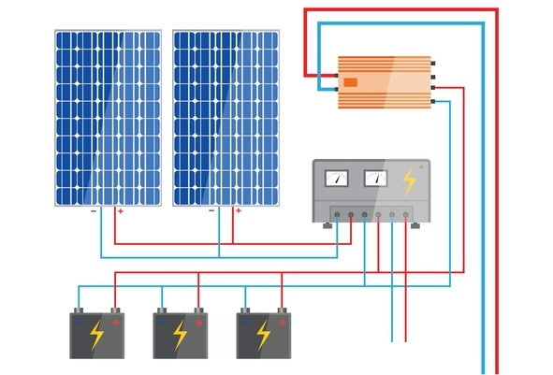
Solar Panel Generator System
The following image depicts the charge controller and the main inverler separately for visual reasons but both components will be enclosed in one device.

Slide 11
Project Costs
Requirements | Costs
Solar panels | $68,000
Solar Generator | $300 - $5000 per set
Solar panel installation | $32,000.00
Panel mount | $15 X 28 (15 KW systems) = $420
Permit & Inspection fees | $50 - $200 per permit
Testing (every 3 years) | $75,000.00
Labor cost | $50,000.00
Total budget (upper bound) | $380,650.00
The table to the right depicts all the direct and indirect costs of completing the project in all the stages.
Since the labor is hired on an annual basis, any delay after ther project begins will cost 50,000 per year extra for labor.
Note: The total budget is for 3 years, which can be paid in 3 installments.

Slide 12
SCHEDULE
Task | Date
Meetings | December 18, 2020 - December 25, 2020
Development | December 25, 2020 - April 30, 2021
Testing | April 30, 2021 - June 20, 2021
Trial period | June 20, 2021 - August 20, 2020
Implementation | August 20, 2021
Long term support | August 20, 2021
The project is expected to start from December 18,2020 and end on August 20, 2021
The progress reports by the team will be delivered each month.
The generator is expected to be inspected after every 3 years and after every natural disaster hits the area.

Slide 13
Expected Project Results
After the completion of the project, which includes the installation of a solar panel and generator system, our company expects the hospital to operate for more than 8 weeks without power supply, where the backup power will run the hospital for a trial of 8 weeks.
Our company expects that during the 8-week trial, the electricity bill from the utility company will also be 0 dollars for Hospital Metropolitano San Francisco.
On the other hand, we anticipate that during the hurricane season our system will sustain any damage from wind and keep supplying the electricity without any issues, while the hurricane ravages the area.
Our company expects to change the solar panels after every 10 years from the date of the installation.

Slide 14
Reference
FS-JH-2018 Kidney Dialysis Machine for Hemodialysis Treatment, Farmasino Pharmaceuticals (Jiangsu) Co., Ltd. on Alibaba.com. (n.d.). Retrieved from https://farmasino.en.alibaba.com/product/60255320370-810103425/FS_JH_2018_Kidney_Dialysis_Machine_for_Hemodialysis_Treatment.html
American BioTech Supply ABT-AFPP-49 49 Cu. Ft. (n.d.). Retrieved November 29, 2020, from Build.com website: https://www.build.com/product/summary/1299581?uid=3093232&jmtest=gg-gbav2_3093232&inv=1&&source=gg-gba-pla_3093232
Fonash, R. T., & Ashok, S. (2018). solar cell | Definition, Working Principle, & Development. In Encyclopædia Britannica. Retrieved from https://www.britannica.com/technology/solar-cell
solar pv power plant single line diagram - Google Search | Solar pv panel, Solar pv, Solar system diagram. (n.d.). Retrieved November 29, 2020, from Pinterest website: https://www.pinterest.com/pin/396739048401106278/
MacDonald, I. (2017, September 27). Health crisis in Puerto Rico: Few hospitals have power or fuel, but public health officials fear the worst is yet to come. Retrieved from https://www.fiercehealthcare.com/healthcare/health-crisis-puerto-rico-few-hospitals-have-power-or-fuel-medical-supplies-dwindle-and

