Slide 1
Life Finder App
Humayara Karim, Anthony Liang, Jerome Galam, Shahjalal Sikder

Slide 2
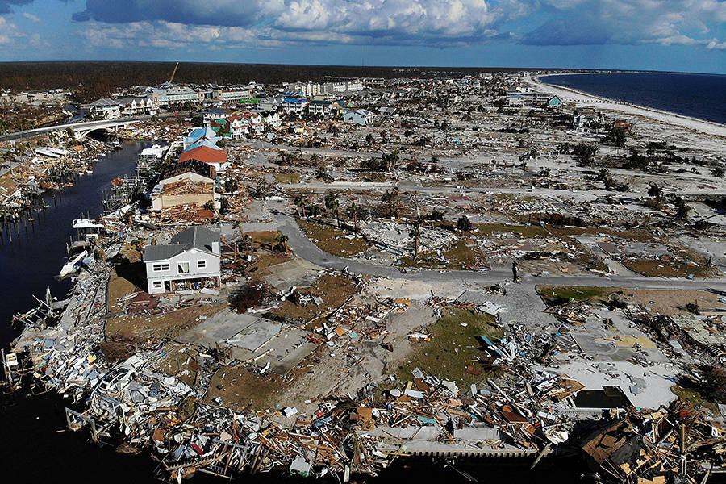
1. Introduction
In 2018, Hurricane Michael caused 47 storm-related deaths and resulted in over 1000 people missing.
Hurricanes are very prevalent
This proposal seeks to develop an application that helps find citizens in need during such disasters.

Slide 3
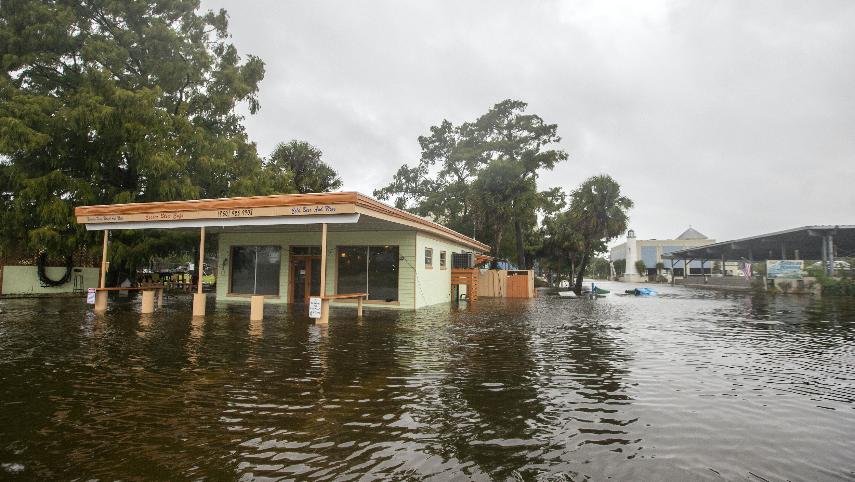
1.1 Problem Statement
Natural Disasters can knock out the Internet
Many people go missing during natural disasters
Notes:
https://www.usatoday.com/in-depth/news/2018/10/10/michael-graphics/1590739002/

Slide 4
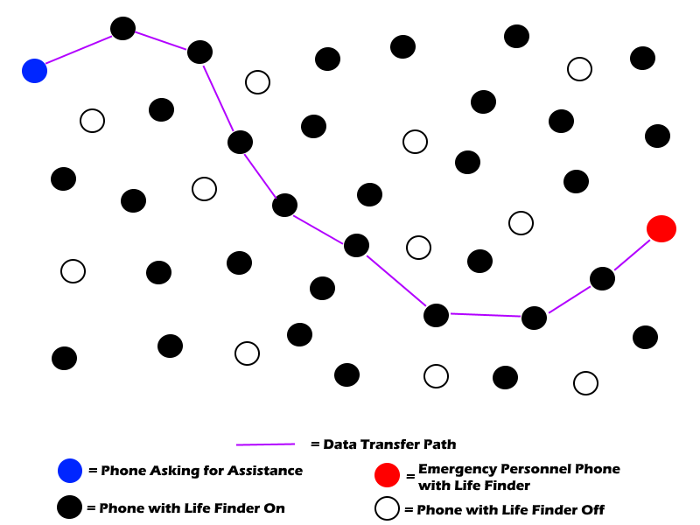
1.2 Background
Mesh networking, which is a technology that utilizes either mobile networks or other phones with the Life Finder app to pass data from point A to point B.

Slide 5
1.3 Needs Statement
We seek funding for the development and distribution of the Life Finder app.
Money will go towards:
Research/Development of app
Testing
Provision of phones
Wages
Need skill specific workers

Slide 6
1.4 Objective
The goal of this app is to deliver help to those who may be trapped, injured, or missing during a situation where they may not be able to ask for help due to the internet being out.

Slide 7
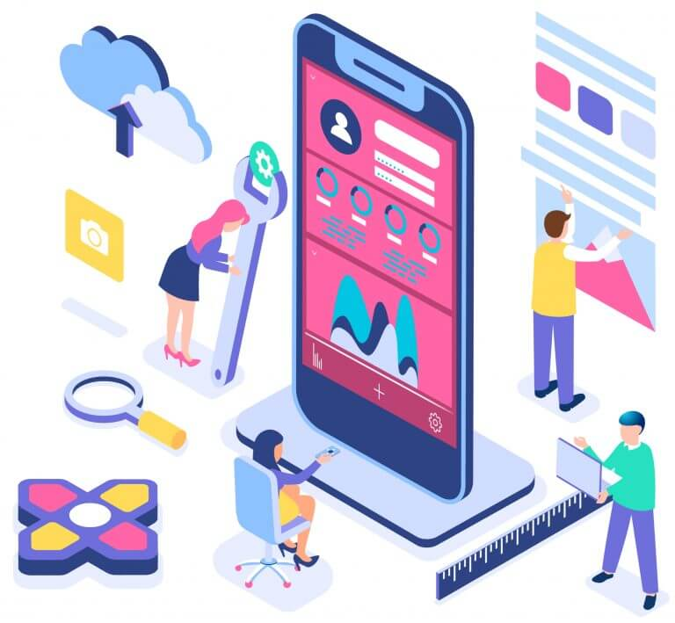
2. Proposed Technical Approach
Employment categories: front-end developers, back-end developers, full-stack developers, and quality assurance engineers
Total budget estimation: $226,000

Slide 8
Costs
Front-End Developer | $70,000 per year
Back-End Developer | $128,000 per year
Full-Stack Developer | $113,000 per year
Quality Assurance Engineer | $50,000 per year
GUI Designer | $10,000
Office Space | $14,800 per year
App Developer Licenses | $100 per year for Apple and one time fee of $25 for Android
Market Research | $10,000 per year
Application Cost | $171,450 per year
Maintenance | $20,000 per year

Slide 9
2.1 Requirements
What does the app need feature-wise?
Option to connect and disconnect from the network
A button to request for assistance
A button to inform users how to use the app
A feature-rich settings menu
Man Thinking
(“Man Thinking”, 2019)

Slide 10
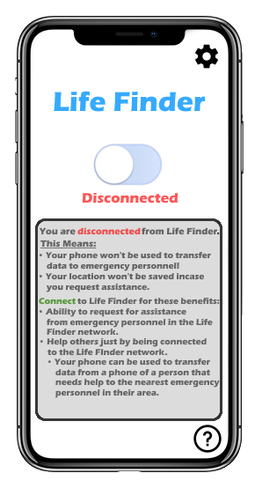
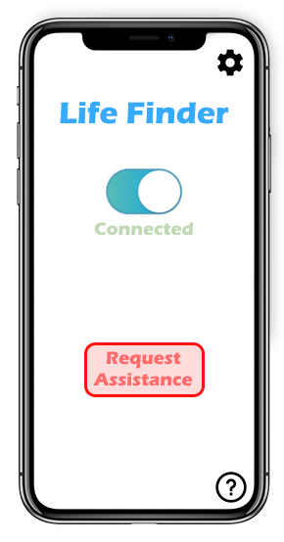
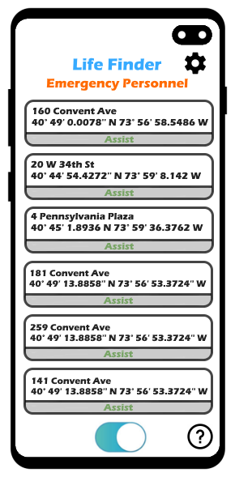
2.2 Architecture Design
Life Finder Off
Life Finder On
Life Finder (Emergency Personnel Version)

Slide 11
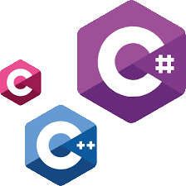
2.3 Implementation Design
Front-end Team:
Back-end Team:
Python Logo
(“Python Logo”, n.d)
HTML, CSS, JavaScript Logo
(“HTML, CSS, JavaScript Logo”, n.d)
C, C#, C++ Logo
(“C, C#, C++ Logo”, n.d)

Slide 12
2.4 Quality Assurance Plan
Goals
User friendly design
Can handle millions of users
Personnel
Making sure all employees are qualified for the job
Funding
Staying on schedule
Bugs
Quality assurance engineers
Controlled testing
Beta testing
Gradual rollout

Slide 13
3. Expected Project Results
Pre-Disaster:
Slow initial growth
Weekly updates
Advertise for app growth
Post Disaster:
Update application
Review outcome of app use
Usage increase

Slide 14
3.1 Measure of Success
Seeing if the Life Finder Network is close to the population size of Florida
App rating from user experience
Testing it with an actual disaster; comparing missing person statistics

Slide 15
4. Schedule
Presentation
(April 28, 2020)
01
Discuss the basics of the app, functionality, and estimated cost of development.
Development
(April 30, 2020 - September 30, 2020)
Beginning work on the Life Finder App.
02
Testing
(October 1, 2020 - October 31, 2020)
03
Begin controlled testing and beta testing.
Marketing
(October 14, 2020)
Start marketing the app to the public.
04
Implementation
(November 1, 2020)
05
Release the app to the public in Florida.
Long Term Support
November 1, 2020
Begin long term support, add additional features such as languages and fix any bugs since launch.
06

Slide 16
References
AppPresser Docs (2020). Apple and Google developer licenses. Retrieved from https://docs.
apppresser.com/article/400-apple-and-google-developer-licenses
Built in NYC (2020). 2020 Front End Developer Salary in NYC (Updated Daily). Retrieved
from https://www.builtinnyc.com/salaries/dev-engineer/front-end-developer/new-york
Business of Apps (n.d.). App Marketing Costs. Retrieved from https://www.businessofapps.com
/marketplace/app-marketing/research/app-marketing-cost/
[C, C#, C++ Logo] (n.d.). [Digital Image] Retrieved April 27, from https://www.fiverr.com/rajarjs/do-your-c-c-plus-plus-or-c-sharp
-assign ments
CNBC (2018). More than 1,000 remain missing a week after Hurricane Michael. Retrieved from https://www.cnbc.com/2018/10/17/more-
Than-a-thousand-remain-missing-a-week-after-hurricane-michael.html
Cynar, M. (2019). How Much Does it Cost to Rent Office Space?. Retrieved from
https://priceithere.com/business-tips/how-much-does-it-cost-to-rent-office-space/
[HTML,CSS,JavaScript Logo] (n.d.). [Digital Image] Retrieved April 27, from https://skywell.software/blog/how-to-make-a-website-with
- javascript-html-and-css/
Indeed (n.d.,a). Back end developer. Retrieved from https://www.indeed.com/career/back-end-de
veloper/salaries
Indeed (n.d.,b). Full stack developer. Retrieved from https://www.indeed.com/career/full-stack-d
eveloper/salaries

Slide 17
References
John et al. (2019). Hurricane Michael. Retrieved from https://www.nhc.noaa.gov/data/tcr/AL142018_Michael.pdf
Lastovetska, A. (2019). App Development Cost: Understand Your Budget To Build Powerful Apps. Retrieved from https://mlsdev.com/
blog/app-development-cost
[Man Thinking] (2019). [Digital Image] Retrieved April 27, from https://www.freepik.com/premium-vector/cartoon-thinking-mem
ium-vector/cartoon-thinking-man-with-quest ion-mark-think-bubble_5494827.htm
Mobile App: Development. [Digital Image]. Retrieved from https://www.avianet.aero/mobile-app-development/
[Python Logo] (n.d.) [Digital Image] Retrieved April 27, from https://www.python.org/community/logos/
Rice, D. (2019). Hurricane Michael: What you need to know in graphics. [Digital] Retrieved from https://www.usatoday.com/in-depth
/news/2018/10/10/michael-graphics/1590739002/
Salary.com (n.d.). Quality Engineer Technician Salary in the United States. Retrieved from https://www.salary.com/research/salary/pos
ting/quality-engineer-technician-salary
Yalantis (n.d.). How Much Does It Cost to Design an App?. Retrieved from https://yalantis.com/ blog/how-much-does-it-cost-to-design
-an-app/

