Slide 1
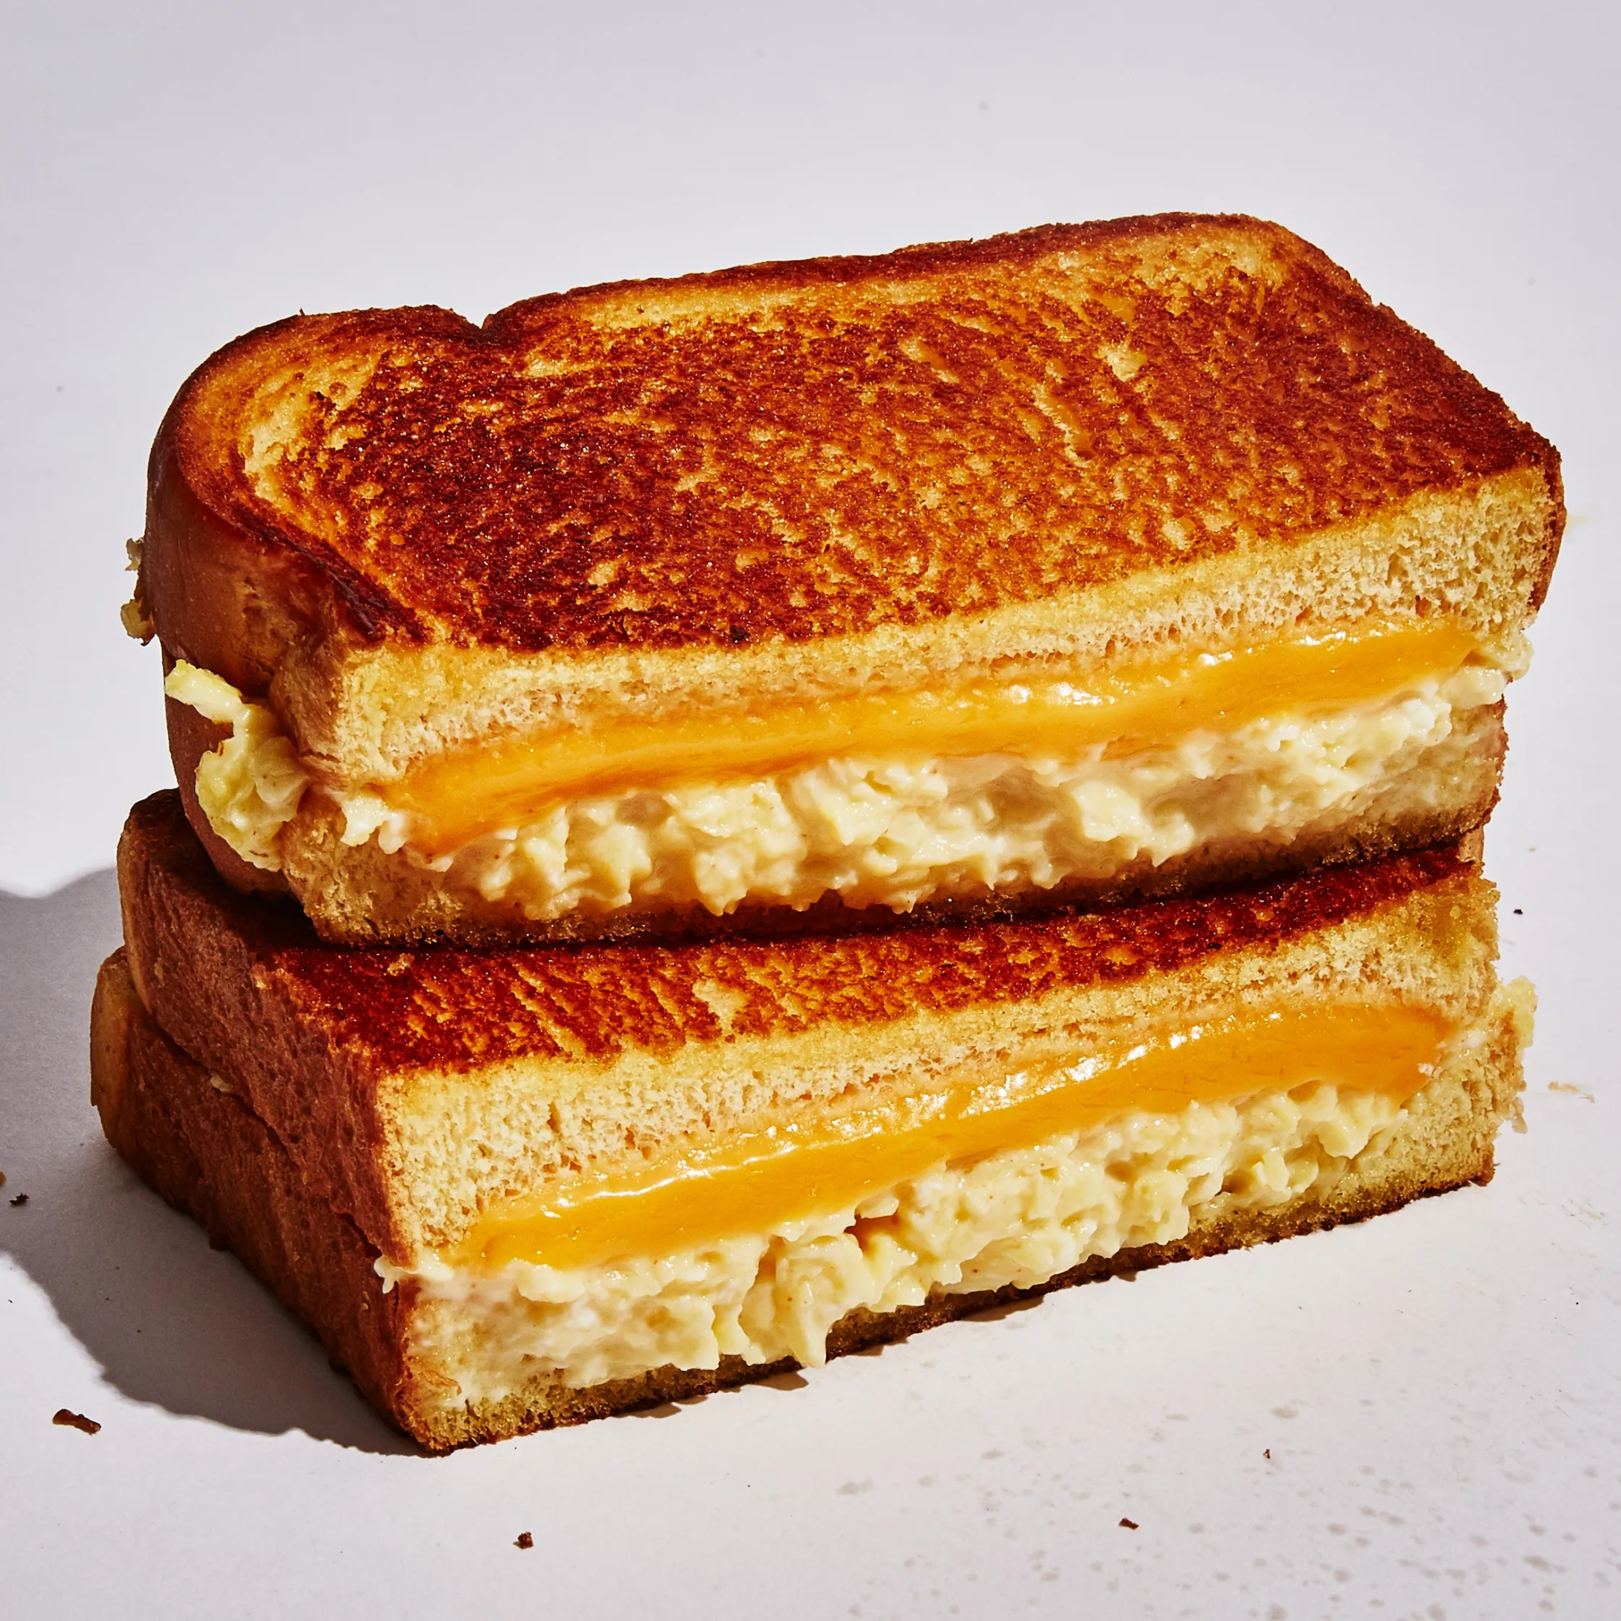
How to make an Egg and Cheese Sandwich
By Javier Guerrero, Rezwan Ahmed and Syed Abedin

Slide 2
Materials needed
Pan
Stove
Toaster
Whisk or a fork
bowl

Slide 3
Ingredients
2 medium eggs
2 pieces of sliced Bread
Cheeses
Butter or cooking oil
Salt
Pepper

Slide 4
Making an Egg and Cheese Sandwich
1. Crack the eggs and place them in a bowl. Use a whisk or a fork to beat the eggs till it's evenly mixed.
2. Get a pan and coat it with butter or some type of cooking oil, and place it on a stove with a medium low heat for 30 seconds to a minute.

Slide 5
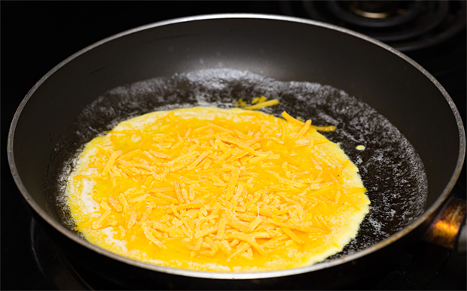
3. Place the beaten eggs into the pan, and then evenly spread a pinch of salt and pepper on to the eggs.
4. Place the bread on the toaster for 3 to 5 minutes at 350 degrees Fahrenheit.
5. After 2 minutes flip the egg and spread the cheese on top of the egg, and cover the pan with a lid. Do not turn off the stove or lower the heat.

Slide 6
6. Remove the eggs from the pan once the cheese has melted. By this time the bread should also be ready.
7. Now that we have our toasted bread and fried egg, we are almost finished. Put the fried eggs in between the 2 toasted breads and enjoy!
Optional: You can cut the sandwich in half or eat as a whole.

Slide 7
References
Dave. (2017). Fried eggs with cheese. Perfect Scrambled Eggs with Cheese – Ready in 5 mins. Hurry The Food Up. Retrieved October 23, 2021, from https://hurrythefoodup.com/scrambled-eggs-with-cheese/.
Differences between used vegetable oil and olive oil. SeQuential. (2019, August 17). Retrieved October 23, 2021, from https://choosesq.com/blog/vegetable-or-olive-does-it-matter-in-used-cooking-oil/.
Cummings, D. (2019, August 7). 10 mistakes you might be making with eggs (and how to fix them!). Taste of Home. Retrieved October 23, 2021, from https://www.tasteofhome.com/collection/mistakes-you-might-be-making-with-eggs/.
Dufresne, W. (2018, February 13). Wylie Dufresne's scrambled egg sandwich. Bon Appétit. Retrieved October 23, 2021, from https://www.bonappetit.com/recipe/breakfast-grilled-cheese-with-soft-scrambled-eggs.

