Slide 1
How to Make S'mores in a Microwave
Asem Sayed, Rifat Rashid, Anisara Malasukum

Slide 2
Figure 1. Boy talking to another boy with caption “Hey, you want a s’more?” (Giphy, 2017).
Well, today is your lucky day because we are going to teach you how to make S’Mores!

Slide 3
Ingredients and Appliances
Ingredients:
Graham cracker
Milk chocolate bar
Marshmallow
Appliances:
Microwave safe plate
Microwave

Slide 4
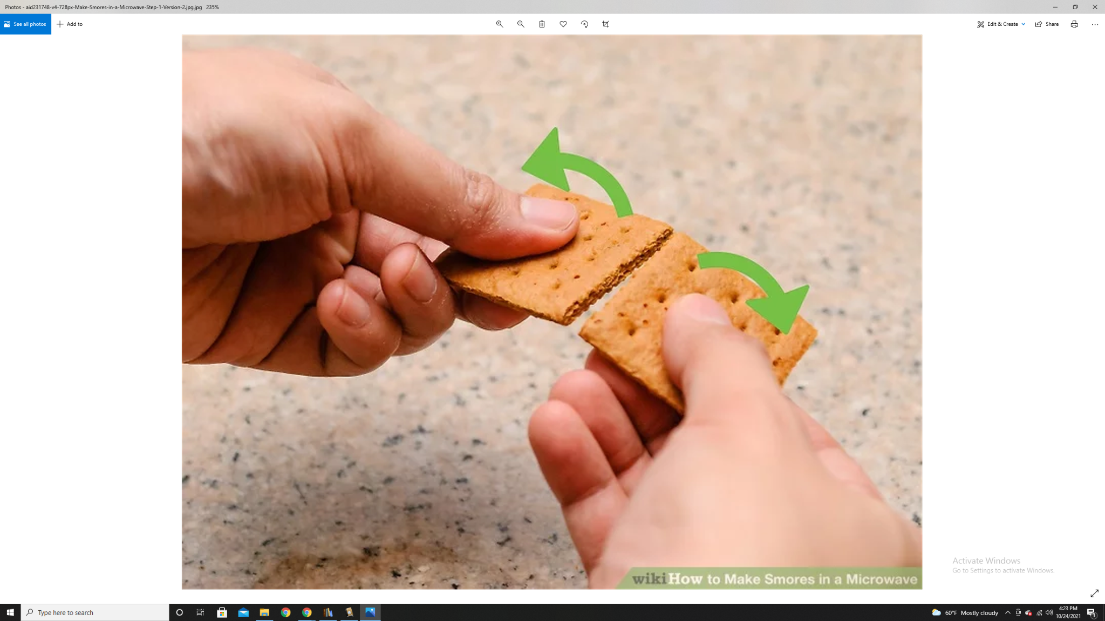
Method
Step 1: Break the graham cracker in half so that it is square-shaped.
Figure 2. Breaking the graham cracker (wikiHow, 2019).

Slide 5
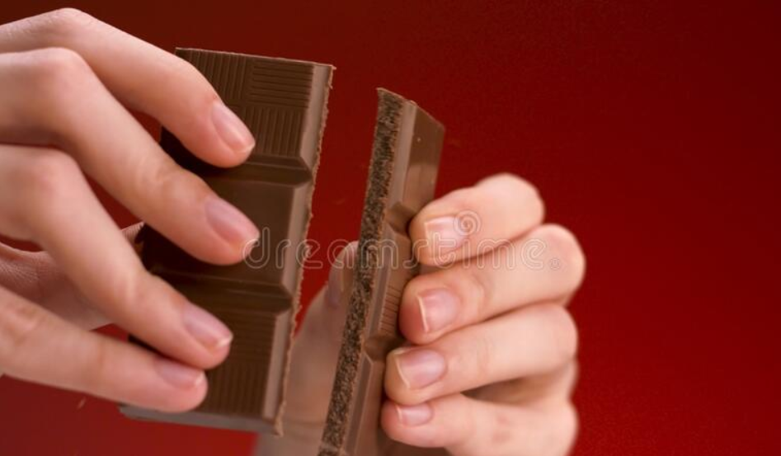
Step 2: Break a piece of chocolate off of the chocolate bar. The piece of chocolate broken must be smaller than the graham cracker.
Figure 3. Breaking the bar of chocolate (Dreamstime, 2020).

Slide 6
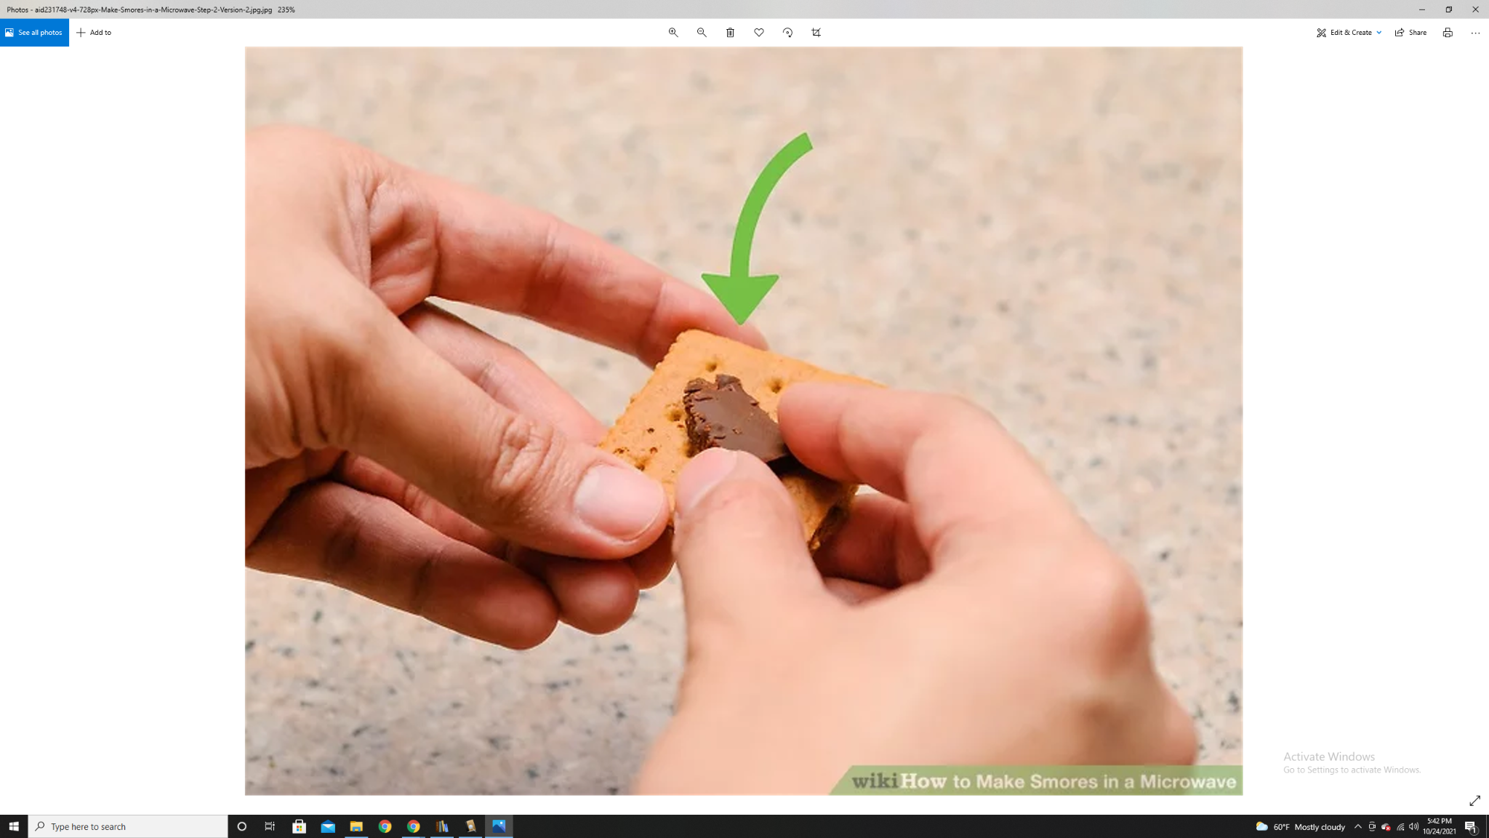
Step 3: Place the piece of chocolate on top of one of the graham crackers.
Figure 4. Placing chocolate on top of the graham cracker (wikiHow, 2019).

Slide 7
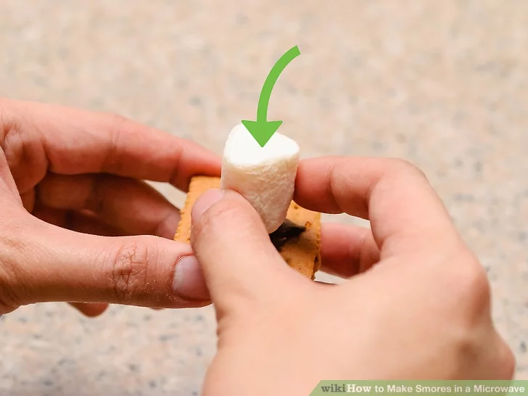
Figure 5. Placing the marshmallow on top of the graham cracker (wikiHow, 2019).
Step 4: Place the marshmallow on top of the graham cracker with the chocolate. Make sure the marshmallow is standing up (see Figure 4).

Slide 8
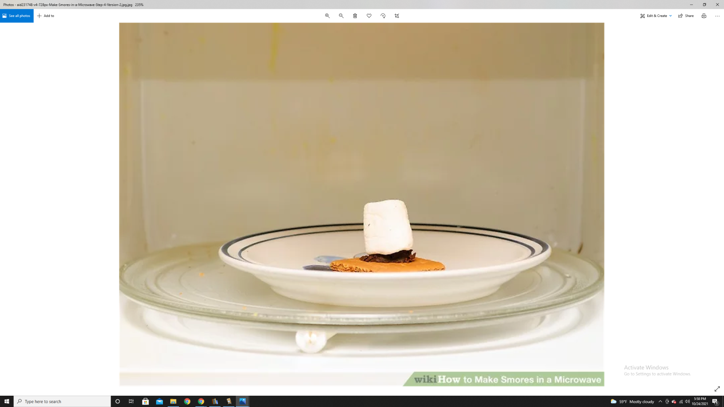
Step 5: Place the partially assembled s’more on the plate. Put the plate in the microwave and heat on high for 15 seconds.
CAUTION: *Very Hot. Adult supervision required.*
Figure 6. Microwaving the s’more (wikiHow, 2019).

Slide 9
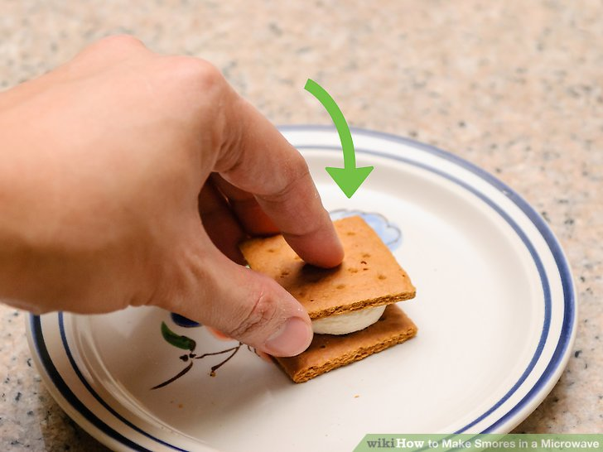
Figure 7. Placing another graham cracker on top of the marshmallow (wikiHow, 2019).
Step 6: Remove the plate with the s’more from the microwave. Place the second half of the graham cracker on top, gently pressing down the marshmallow.
*Don't press too hard or the cracker will break*

Slide 10
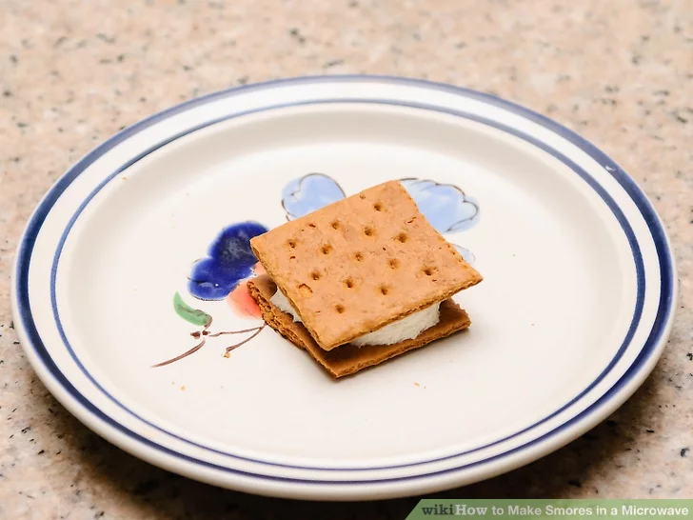
Figure 8. Cooling the s’more (wikiHow, 2019).
Step 7: Allow the s’more to cool down for about 3 minutes minutes.

Slide 11
Figure 9. Buzz Lightyear talking to Woody from Toy Story with caption “Eating Delicious Hot Schmoes” (Giphy, 2021).
Step 8: Enjoy the gooey deliciousness.

Slide 12
References
Dreamstime. (2020). Close up of woman hands breaking a milk chocolate bar isolated on red background. Dreamstime. https://www.dreamstime.com/close-up-woman-hands-breaking-milk-chocolate-bar-isolated-red-background-stock-footage-concept-sweets-confectionary-image206514814
Giphy. (2017). Hey, you want a s’more?
https://media.giphy.com/media/3oKHW7l4tHcXC60cXC/giphy.gif
Giphy. (2021). Making Delicious Hot Schmoes.
https://media.giphy.com/media/BSRYVoTtw8saLgseuB/giphy.gif
wikiHow Staff. (2019, March 29). How to Make Smores in a Microwave. wikiHow. https://www.wikihow.com/Make-Smores-in-a-Microwave

