Slide 1
How to Cook a Pot of Rice
Homioun, Jason, Tanveer

Slide 2
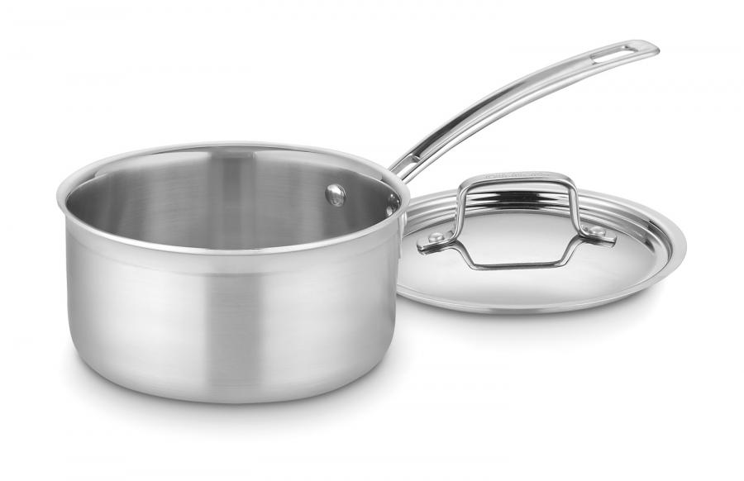
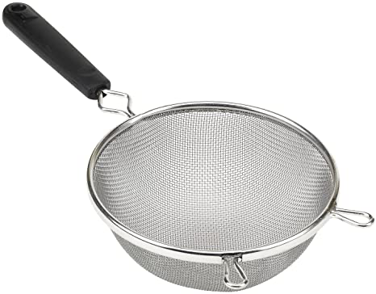
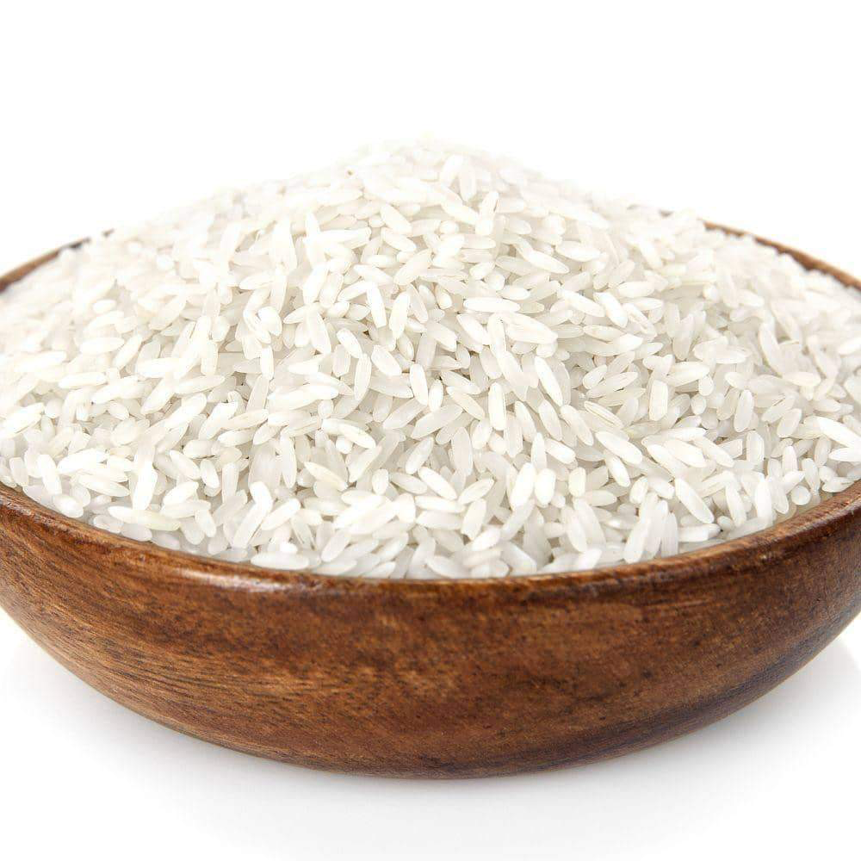
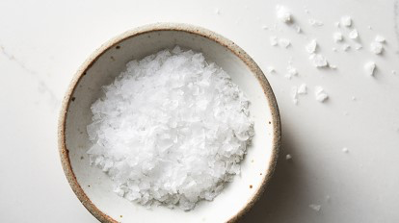
What You’ll Need
Pot (2-4 quarts pots are ideal for 1-2 cups of rice)
Strainer
Your choice of rice (long-grain white rice is most commonly used)
Salt (optional)

Slide 3
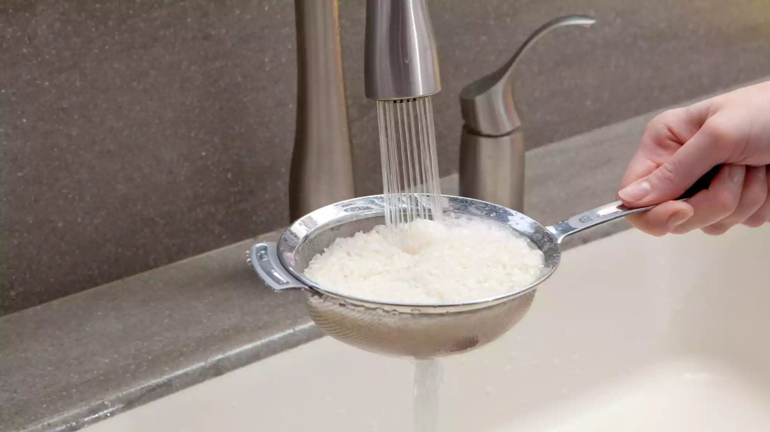
Rinse Your Rice
With your strainer you are going to rinse your rice under running water until the water runs clear.
*This step helps remove any excess starch from the rice*

Slide 4
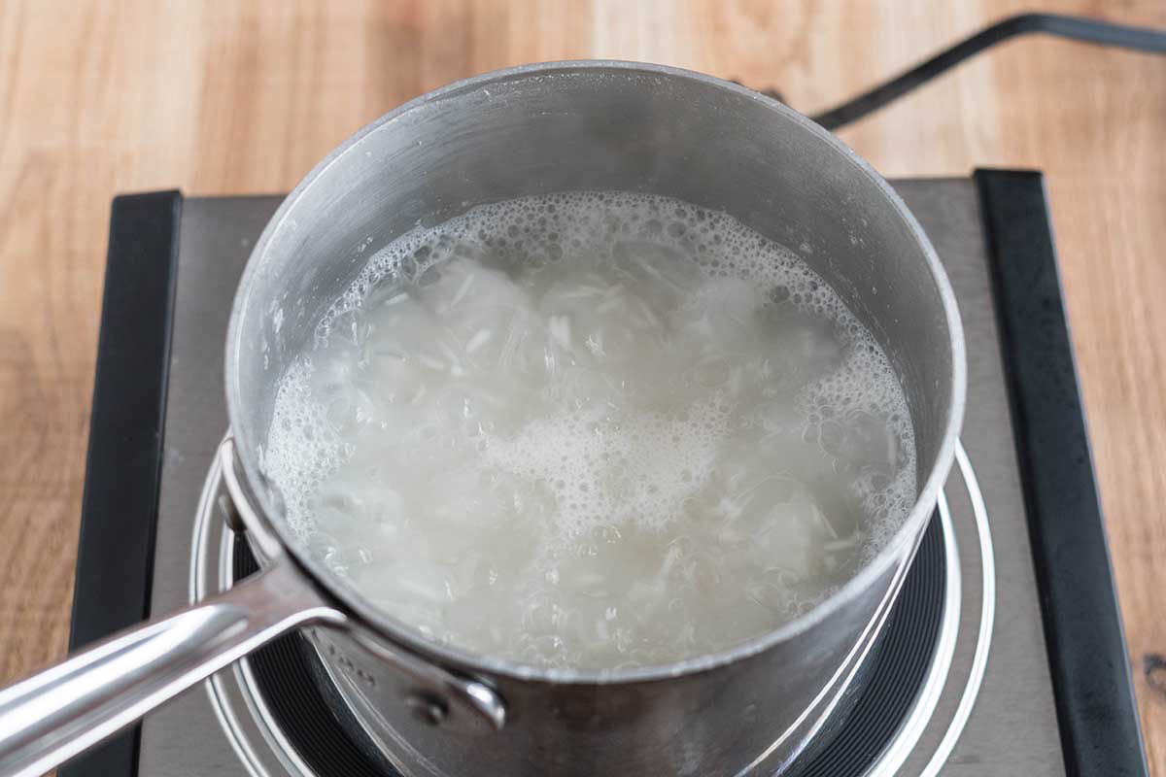
Bring Your Rice to a Boil
Add your preferred rice to your pot and fill with water. It is important to note that you will need different amounts of water depending on the type of rice you use (2 cups of water per cup of long-grain white rice, 1 ¼ cups of water per cup of short-grain white rice, and 1 ¾ cups of water per cup of brown rice). Add an optional pinch of salt and bring it to a boil at high heat.

Slide 5
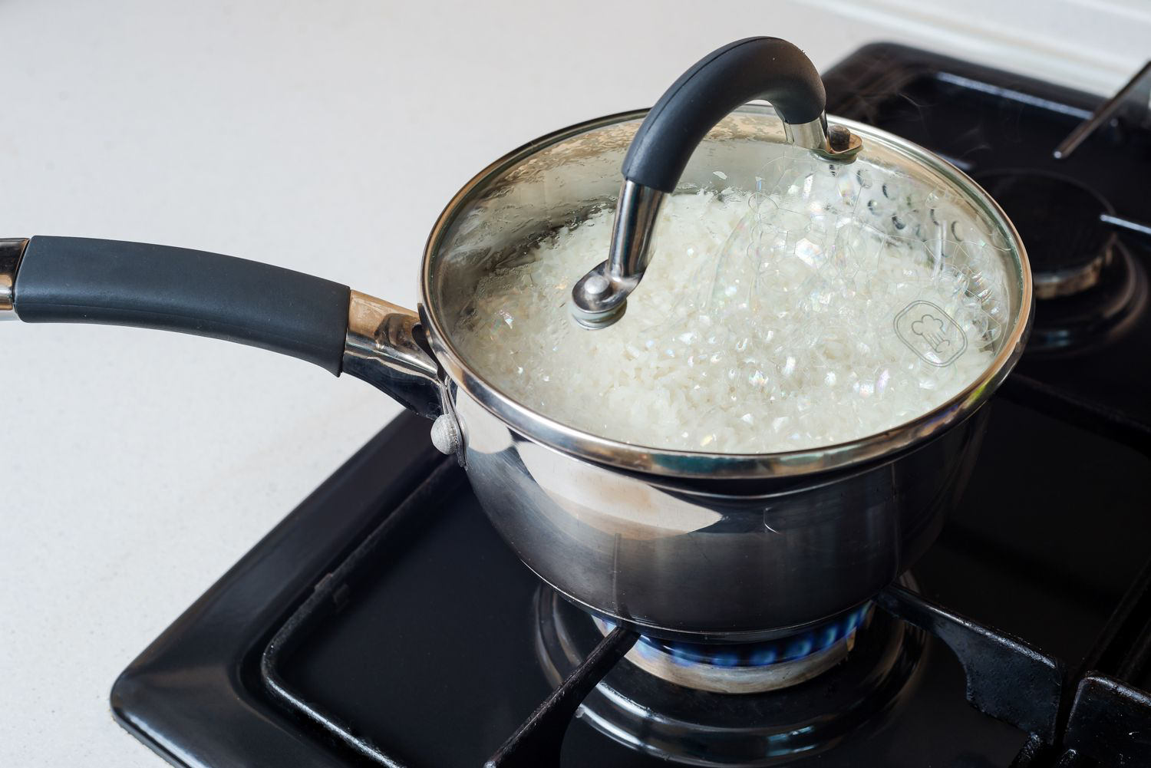
Let Your Rice Simmer
After the water begins to boil, stir your rice and put on the lid. Now you will turn the heat down to a simmer (lowest heat). Cooking times will differ depending on the type of rice (keep long-grain white rice for 18 minutes on simmer, short-grain for 15 minutes on simmer, and brown rice for 45 minutes on simmer).
*DO NOT remove the lid as the rice is cooking*

Slide 6
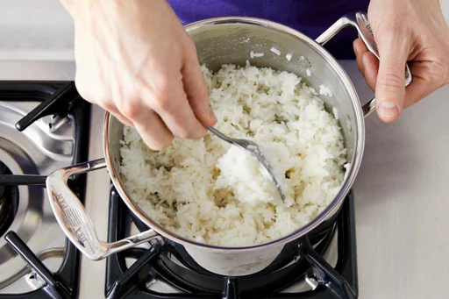
Additional Steaming
After the rice is done cooking, remove the lid and let your rice steam for an additional 5-10 minutes while stirring occasionally.
*This will make your rice extra fluffy*

Slide 7
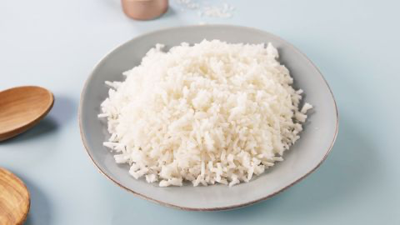
Enjoy
Turn the heat off completely and enjoy your perfectly cooked pot of rice!

