Slide 1
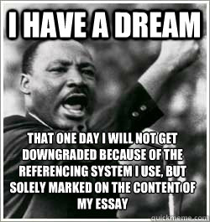
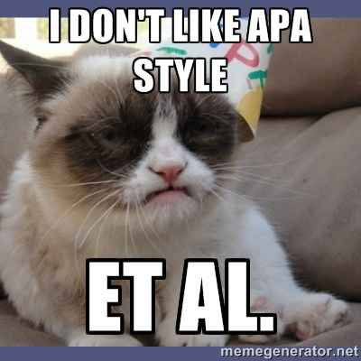
APA Citations
Quick How To

Slide 2
This lesson intends to…
Discuss with students how to construct citations in APA format
Remind students how to avoid plagiarism
Discuss with students how to construct reference pages
Incorporate an activity designed to practically apply skills learned in this lesson
Address the citation generator…

Slide 3
Why do we cite sources?
To. Avoid. Plagiarism!

Slide 4
What sources need citing?
ANY quotation, chart, graph, visual, controversial statement, idea, opinion, or conclusion NOT YOUR OWN.

Slide 5
What sources do NOT need citing?
Any well known quotations, documents, or knowledge.
Rule of thumb: if the same piece of information appears in three or more different locations, it is considered “well-known” and need not be cited.

Slide 6
What is APA style citing?
https://www.mendeley.com/guides/apa-citation-guide/
An in-text citation is a citation within your writing that shows where you found your information, facts, quotes, and research. All APA in-text citations require the same basic information:
Author’s last name (no first names or initials)
Year of publication (or “n.d.” if there is “no date”:(LastName, n.d., p.#))
Page number, paragraph number, chapter, section, or time stamp where the information can be located within the source (only required for direct quotes)

Slide 7
In text citations: APA
https://owl.purdue.edu/owl/research_and_citation/apa_style/apa_formatting_and_style_guide/in_text_citations_the_basics.html
APA (in most cases) is simply the author last name, the year of publication, and often a page number in the parenthesis at the end of the citation. Most often, the signal phrase includes the author last name, in which then year and page number are required.
Yanovski and Yanovski (2002) reported that “the current state of the treatment for obesity is similar to the state of treatment of hypertension several decades ago” (p. 600).
*note that the page citation includes p. and punctuation goes outside of the parenthesis
*if there the author is not named in the signal phrase, place the author’s name, the year, and the page number in parentheses after the quotation (Critser, 2003, p.5)

Slide 8
In text citations: what is a signal phrase?
https://www.youtube.com/watch?v=_fVv2Jt0o18
Signal phrase- a phrase used to tell readers who is making the assertion and why he/she has the authority/knowledge to speak on a source. Also, it tells the reader that everything between the signal phrase and parenthetical citation comes from that source (NFG 473)
*APA style requires usage of the past tense or the present perfect tense in signal phrases introducing cited material
Smith (2012) reported
Smith (2012) has argued
According to Professor Smith (2020), everything important in between either summarized, paraphrased, or quoted, in which case it would have quote marks around it (Smith, 2020).

Slide 9
How to cite in APA style- short vs long quotes
How to quote in text in APA format- (Markel 634-650) and Purdue OWL website
Short quotes- If you are directly quoting from a work, you will need to include the author, year of publication, and page number for the reference (preceded by "p." for a single page and “pp.” for a span of multiple pages, with the page numbers separated by an en dash).
Long quotes, called block quotes- **anything longer than 40 words
Place direct quotations that are 40 words or longer in a free-standing block of typewritten lines and omit quotation marks.
Start the quotation on a new line, indented 1/2 inch from the left margin, i.e., in the same place you would begin a new paragraph.
Type the entire quotation on the new margin, and indent the first line of any subsequent paragraph within the quotation 1/2 inch from the new margin.
Maintain double-spacing throughout, but do not add an extra blank line before or after it. The parenthetical citation should come after the closing punctuation mark.

Slide 10
For example: Short Quotations

Slide 11
For example: Long Quotations

Slide 12
Yes, you have to do a reference page
https://www.bibliography.com/apa/apa-reference-page-examples-and-format-guide/
An APA reference page is where you find all the references for the in-text citations included in your research. It provides the who, when, what, and where information for each different resource you used.
the difference between a reference citation and an in-text citation.
A reference is listed only on the APA reference list;
an in-text citation is created throughout the body of the text. Every in-text citation, beyond those specified by APA, has a corresponding reference list on the References page.

Slide 13
Let’s talk about this one…
However, other studies have shown that even gender-neutral antecedents are more likely to produce masculine images than feminine ones (Gastil, 1990). Hamilton (1988) asked students to complete sentences that required them to fill in pronouns that agreed with gender-neutral antecedents such as “writer,” “pedestrian,” and “persons” (Hamilton, 1988). The students were asked to describe any image they had when writing the sentence. Hamilton found that people imagined 3.3 men to each woman in the masculine “generic” condition and 1.5 men per woman in the unbiased condition. Thus, while ambient sexism accounted for some of the masculine bias, sexist language amplified the effect.
(Source: Erika Falk and Jordan Mills, “Why Sexist Language Affects Persuasion: The Role of Homophily, Intended Audience, and Offense,” Women and Language19:2.

Slide 14
What else you can do with quoting…Nevermind MLA!
When he arrives at this realization it is far too late. He has literally created a monster: “I beheld the wretch- the miserable monster whom I created” (59) He “sought to avoid the wretch” (60) because he was “unable to endure the aspect of the being [he] created” (58) and flees both the creation and his responsibility for it and spends the rest of the narrative fearing its possible retaliation.
John Bugg argues, “by [the monster] acquiring literacy, he only becomes more familiar… with the terms of his own alterity” (Bugg 661).
The monster absorbs and repeats the slurs and biases of racial superiority: “the slothful Asiatics; [versus] the stupendous genius and mental activity of the Grecians” (Shelley 122).

Slide 15
A note about citation generators…

